Slide 1
STRICTLY CONFIDENTIAL · PRE-SERIES A
Product Lines
Fifteen SKUs, explained
For each product: what it is, how it works on the shared silicon, who buys it, and what it contributes.
15 SKUs
One chip
FOUR SLIDES EACH
SoC2 · 28 NM
All figures are management projections prepared for fundraising purposes.
August 2026
Notes:
SKU explainer. Storyboard: storyboard-sku-explainer.md. Figures: Revenue Build rows 44-58 and 61-75; pools from Demand & TAM section B.

Slide 2
HOW TO READ THIS DECK
Every SKU gets the same four slides
Learn the pattern once and you can navigate all fifteen products.
A · What it is
B · How it works
C · Who buys it
D · How it fits
If you held one, what would you be holding
What the silicon actually does in this product
Buyer, channel and the trigger to purchase
What it contributes and what it depends on
PART
SKUS
FY2032 REVENUE
SHARE
ROLE IN THE PORTFOLIO
Road autonomy
3
₹762 Cr
67.5%
Three kits, one chip, ₹762 Cr
Silicon & compute
5
₹194 Cr
17.2%
Selling the chip, not the vehicle
Fleet & mobility
2
₹88.7 Cr
7.9%
Highest revenue per unit we sell
Sensors & robotics
5
₹83.5 Cr
7.4%
Capability, channel and a second cycle
The one thing to carry through
Every SKU here runs the same SoC2 silicon under different firmware — one tapeout, not fifteen independent product bets.
DEEPGRID SEMI · PRODUCT LINES · MANAGEMENT PROJECTIONS
02
Notes:
Reading key. The four-slide unit is the deck grammar.

Slide 3
WHY NOW
The mandate is a demand floor, not a forecast
Compliance dates are set. The buying decision is when, not whether.
1.0 M
0.5 M
0.5 M
18,000
TRUCKS A YEAR IN SCOPE
NEW BUILD, ANNUALLY
EXISTING FLEET RETROFIT
OUR FY2032 AD2 UNITS
MAR 2025
APR 2026
OCT 2026
OCT 2027
Rule notified
New models
Existing models
Braking
Sets the ADAS obligation for N2/N3 vehicles
Drowsiness, blind-spot and lane-departure required
Obligation reaches the in-service fleet
Advanced emergency braking on a separate schedule
What a floor means for an investor
A mandated purchase removes the hardest question in hardware — whether the buyer will pay for safety. Execution risk stays ours: certification and installation throughput.
DEEPGRID SEMI · PRODUCT LINES · MANAGEMENT PROJECTIONS
03
Notes:
Mandate framing per the demand schedule.

Slide 4
THE MOVE
One chip, priced for the mandate
A phased 28 nm programme: prove the blocks, then the die, then commit the mask.
$3.17 M
$3.88
175k
4
PROGRAMME COST
COST PER DIE
DIES TO REPAY IT
GATED STAGES
Block prototypes
Full-die prototype
Backend to GDSII
Production mask
Compute and radar blocks on a shared wafer
57 mm² device, shared wafer
Physical design and sign-off
Committed only once silicon works
Why this is the thing to fund
Silicon absorbs 66.2% of the equity round, and every SKU in this deck is downstream of it. Sign-off and the mask are committed only after working silicon exists.
DEEPGRID SEMI · PRODUCT LINES · MANAGEMENT PROJECTIONS
04
Notes:
Tapeout economics from the unit-economics schedule.

Slide 5
THE SILICON
What the part actually is
One 28 nm die under every SKU in this deck. Configuration changes; the compute does not.
PARAMETER
SPECIFICATION
WHY AN INVESTOR SHOULD CARE
Process
TSMC 28 nm · single die, ~57 mm²
Monolithic, not chiplet — less cost and less risk.
Compute
32,768 MACs at 600 MHz · 39.3 TOPS
64 compute cubes of 512 MACs. Derived, not rounded up.
Memory
102.4 GB/s dual-channel LPDDR5
Bandwidth, not TOPS, binds multi-camera fusion.
Transformer
Hardware softmax · weight-stationary attention
The operation an FPGA cannot do at frame rate.
Safety
Lockstep cores plus a hardware root of trust
The path to an automotive safety rating.
Throughput
Eleven sensor channels fused in 8.6 ms
Of a 33.3 ms frame budget — 74% left unused.
The one number that explains the portfolio
A part that clears eleven channels in a quarter of its frame budget configures downward into a one-channel module, a mirror unit, a radar pod or a forklift kit without redesigning the compute. That headroom is why fifteen SKUs are one tapeout, not fifteen programmes.
DEEPGRID SEMI · PRODUCT LINES · MANAGEMENT PROJECTIONS
05
Notes:
SoC2 specification. Headroom is what permits the SKU fan-out; every configuration below eleven channels is a firmware and front-end change, not a new die.

Slide 6
THE PORTFOLIO
Fifteen SKUs across four platform surfaces
Sorted by FY2032 revenue. Same silicon, priced independently by market.
SKU
PRICE
FY32 REV.
SHARE
GM
FIRST
SKU
PRICE
FY32 REV.
SHARE
GM
FIRST
Smart Truck (AD2 kit)
₹2.50 L
₹450 Cr
39.9%
89%
FY2027
A100 compute box 2ch
₹1.60 L
₹28.8 Cr
2.5%
89%
FY2028
AD0 Smart Mirror
₹50,000
₹270 Cr
23.9%
89%
FY2027
A100 compute box 1ch M.2
₹85,000
₹25.5 Cr
2.3%
89%
FY2028
Autonomous TaaS
₹66.00 L
₹66.0 Cr
5.8%
89%
FY2028
Seaport AGV
₹45.30 L
₹22.6 Cr
2.0%
89%
FY2028
Chipset OEM B2B
₹18,000
₹54.0 Cr
4.8%
94%
FY2028
D100 drone SoC kit
₹5.00 L
₹20.0 Cr
1.8%
68%
FY2028
T100 AI licence
₹100.00 L
₹50.0 Cr
4.4%
94%
FY2029
Thermal camera
₹50,000
₹16.0 Cr
1.4%
50%
FY2027
AD1 Indoor L4 kit
₹1.00 L
₹42.0 Cr
3.7%
89%
FY2028
H100 driver monitor
₹5,000
₹10.0 Cr
0.9%
50%
FY2027
A100 compute box 4ch PCIe
₹3.00 L
₹36.0 Cr
3.2%
89%
FY2028
4D radar pod
₹25,000
₹7.50 Cr
0.7%
50%
FY2027
Defence D-HUMR
₹20.00 L
₹30.0 Cr
2.7%
68%
FY2027
DEEPGRID SEMI · PRODUCT LINES · MANAGEMENT PROJECTIONS
06
Notes:
All fifteen SKUs; totals reconcile to ₹1,128.45 Cr.

Slide 7
PART ONE
Road autonomy
₹762 Cr · 67.5% of FY2032 · 3 SKUs · Three kits, one chip, ₹762 Cr
DEEPGRID SEMI · PRODUCT LINES · MANAGEMENT PROJECTIONS
07
Notes:
Road autonomy: AD0 Smart Mirror (mandate retrofit), AD1 Indoor L4 kit, Smart Truck (AD2 kit).

Slide 8
AD0 SMART MIRROR · A
What it is
A replacement mirror unit with an integrated display, four body cameras and a wiring loom.
₹50,000
Systems
Outdoor
FY2027
UNIT PRICE
SEGMENT
OPERATING DOMAIN
FIRST REVENUE
WHAT IS IN IT
01
02
03
04
Four surround cameras with mounting hardware
Mirror-format display head unit
SoC2 compute integrated in the head unit
Recording storage and alert speaker
How it is positioned
AD0 Smart Mirror (mandate retrofit) sells at ₹50,000 into the road autonomy surface. The volume ramp of the portfolio: highest unit count of any SKU and the lowest fitment complexity, so it scales channel reach that the harder products later inherit.
DEEPGRID SEMI · PRODUCT LINES · MANAGEMENT PROJECTIONS
08
Notes:
AD0 Smart Mirror (mandate retrofit) — what it is. Price ₹50,000, segment Systems, domain Outdoor, first revenue FY2027.

Slide 9
AD0 SMART MIRROR · B
How it works
Sense, compute on SoC2, decide, act — the same four stages in every product.
SIGNAL CHAIN
1
Four cameras cover the vehicle's blind quarters
2
SoC2 stitches the views into one 360° surround image
3
Proximity and motion logic flags anything entering the danger zone
4
Driver sees the stitched view and hears a directional alert
What the silicon does here
What this product depends on
The SoC2 stage is common to every SKU: it is the same perception compute under different firmware. For AD0 Smart Mirror it runs stage two of the chain above.
Distribution reach and price holding at ₹50k. It runs on current-generation hardware, so it is not gated on the ASIC.
DEEPGRID SEMI · PRODUCT LINES · MANAGEMENT PROJECTIONS
09
Notes:
AD0 Smart Mirror (mandate retrofit) — signal chain: Four cameras cover the vehicle's blind quarters -> SoC2 stitches the views into one 360° surround image -> Proximity and motion logic flags anything entering the danger zone -> Driver sees the stitched view and hears a directional alert. Depends on: Distribution reach and price holding at ₹50k. It runs on current-generation hardware, so it is not gated on the ASIC.

Slide 10
AD0 SMART MIRROR · C
Who buys it, and why now
No mandate applies. Buyers pay for visibility and parking safety — which is why it already sells.
The buyer
The channel
Vehicle owners and small fleets, bought as an accessory rather than specified into a vehicle programme.
Aftermarket accessory retail and fitment shops, plus OEM accessory catalogues.
Demand pool · 0.93% capture at FY2032
Existing 360 surround-view market $3.1B (already selling). Our FY2032 volume of 54,000 units is 0.93% of that pool.
Source: Towards Automotive: $3.09B 2025, 10.7% CAGR. Capture rates are management assumptions; pool sizes are third-party published estimates.
DEEPGRID SEMI · PRODUCT LINES · MANAGEMENT PROJECTIONS
10
Notes:
AD0 Smart Mirror (mandate retrofit) — buyer: Vehicle owners and small fleets, bought as an accessory rather than specified into a vehicle programme. Channel: Aftermarket accessory retail and fitment shops, plus OEM accessory catalogues. Trigger: No mandate applies. Buyers pay for visibility and parking safety — which is why it already sells. Pool: Existing 360 surround-view market $3.1B (already selling) (0.93%). Source: Towards Automotive: $3.09B 2025, 10.7% CAGR.

Slide 11
AD0 SMART MIRROR · D
How it fits the overall picture
₹270 Cr at FY2032 — 23.9% of group revenue, at 89% gross margin.
54,000
₹270 Cr
23.9%
89%
FY2032 UNITS
FY2032 REVENUE
SHARE OF GROUP
GROSS MARGIN
UNITS SHIPPED
REVENUE, ₹ CR
54,000
270
34,000
170
8,000
18,000
40
90
10
2,200
0
11
FY27
FY28
FY29
FY30
FY31
FY32
FY27
FY28
FY29
FY30
FY31
FY32
Its role in the portfolio
What it depends on
The volume ramp of the portfolio: highest unit count of any SKU and the lowest fitment complexity, so it scales channel reach that the harder products later inherit.
Distribution reach and price holding at ₹50k. It runs on current-generation hardware, so it is not gated on the ASIC.
DEEPGRID SEMI · PRODUCT LINES · MANAGEMENT PROJECTIONS
11
Notes:
AD0 Smart Mirror (mandate retrofit) — units 10 / 2200 / 8000 / 18000 / 34000 / 54000, revenue 0.05 / 11 / 40 / 90 / 170 / 270 ₹Cr. FY2032 ₹270 Cr = 23.93% at 89%. Role: The volume ramp of the portfolio: highest unit count of any SKU and the lowest fitment complexity, so it scales channel reach that the harder products later inherit.

Slide 12
AD1 INDOOR L4 KIT · A
What it is
A self-driving retrofit kit for indoor vehicles: sensor head, compute box and a drive-by-wire interface.
₹1.00 L
Systems
Indoor
FY2028
UNIT PRICE
SEGMENT
OPERATING DOMAIN
FIRST REVENUE
WHAT IS IN IT
01
02
03
04
Camera and depth sensing head
SoC2 compute box
Drive-by-wire actuation interface
Site mapping and commissioning tooling
How it is positioned
AD1 Indoor L4 kit sells at ₹1.00 L into the road autonomy surface. Where level-4 behaviour ships years before it is legal on a public road, on exactly the same silicon — the technical proof point for the road roadmap.
DEEPGRID SEMI · PRODUCT LINES · MANAGEMENT PROJECTIONS
12
Notes:
AD1 Indoor L4 kit — what it is. Price ₹1.00 L, segment Systems, domain Indoor, first revenue FY2028.

Slide 13
AD1 INDOOR L4 KIT · B
How it works
Sense, compute on SoC2, decide, act — the same four stages in every product.
SIGNAL CHAIN
1
Cameras and depth sensing read the aisle, load and people
2
SoC2 localises the vehicle against a site map it holds onboard
3
Planner picks a path and a speed for the geofenced route
4
Drive-by-wire interface issues steer, throttle and brake
What the silicon does here
What this product depends on
Indoor autonomy is where the silicon runs closed-loop rather than advisory. A 24 m LiDAR at 5 Hz and a 57° camera fuse into one bird’s-eye occupancy view, and the planner drives to it at up to 1.5 m/s inside a ring-fenced safety zone — the vehicle steers, not the driver.
Site mapping and commissioning throughput, which is services capacity rather than product.
DEEPGRID SEMI · PRODUCT LINES · MANAGEMENT PROJECTIONS
13
Notes:
AD1 Indoor L4 kit — signal chain: Cameras and depth sensing read the aisle, load and people -> SoC2 localises the vehicle against a site map it holds onboard -> Planner picks a path and a speed for the geofenced route -> Drive-by-wire interface issues steer, throttle and brake. Depends on: Site mapping and commissioning throughput, which is services capacity rather than product.

Slide 14
AD1 INDOOR L4 KIT · C
Who buys it, and why now
Inside a private site no homologation applies, so deployment is a commercial decision.
The buyer
The channel
Warehouse and industrial operators automating repetitive internal movement.
Direct to site operators and through material-handling integrators.
Demand pool · — capture at FY2032
Warehouse/industrial autonomy; part of $4.8B edge-AI. Our FY2032 volume of 4,200 units is — of that pool.
Source: Dataintelo/GMI automotive edge-AI 2025. Capture rates are management assumptions; pool sizes are third-party published estimates.
DEEPGRID SEMI · PRODUCT LINES · MANAGEMENT PROJECTIONS
14
Notes:
AD1 Indoor L4 kit — buyer: Warehouse and industrial operators automating repetitive internal movement. Channel: Direct to site operators and through material-handling integrators. Trigger: Inside a private site no homologation applies, so deployment is a commercial decision. Pool: Warehouse/industrial autonomy; part of $4.8B edge-AI (—). Source: Dataintelo/GMI automotive edge-AI 2025.

Slide 15
AD1 INDOOR L4 KIT · D
How it fits the overall picture
₹42.0 Cr at FY2032 — 3.7% of group revenue, at 89% gross margin.
4,200
₹42.0 Cr
3.7%
89%
FY2032 UNITS
FY2032 REVENUE
SHARE OF GROUP
GROSS MARGIN
UNITS SHIPPED
REVENUE, ₹ CR
4,200
42
2,200
22
400
1,000
4
10
0
20
0
0
FY27
FY28
FY29
FY30
FY31
FY32
FY27
FY28
FY29
FY30
FY31
FY32
Its role in the portfolio
What it depends on
Where level-4 behaviour ships years before it is legal on a public road, on exactly the same silicon — the technical proof point for the road roadmap.
Site mapping and commissioning throughput, which is services capacity rather than product.
DEEPGRID SEMI · PRODUCT LINES · MANAGEMENT PROJECTIONS
15
Notes:
AD1 Indoor L4 kit — units 0 / 20 / 400 / 1000 / 2200 / 4200, revenue 0 / 0.2 / 4 / 10 / 22 / 42 ₹Cr. FY2032 ₹42.0 Cr = 3.72% at 89%. Role: Where level-4 behaviour ships years before it is legal on a public road, on exactly the same silicon — the technical proof point for the road roadmap.

Slide 16
AD1 INDOOR L4 KIT · E
Proven in a working simulator
A drawable warehouse floor where the same stack runs a real put-away and pick route
LIVE DEMONSTRATOR
AMR Forklift · Dark-Store Sim
Author the site
Populate the hazards
Waypoints snap to aisles; inbound put-away, pick run and a peak-hour floor ship as presets.
Workers, hi-vis staff, peer AMRs, trolleys, spills and pallets are placed on the map and the vehicle must resolve them.
Graded response
Recovery is explicit
Honk, voice, both or silent — with configurable on-time and gap, because an indoor alert policy is a site decision.
Auto-reroute after a set stuck-time, which is the operational question every warehouse buyer asks first.
The demonstrator runs the production perception stack against a simulated environment. It is evidence of the decision layer, not of a fielded deployment.
DEEPGRID SEMI · PRODUCT LINES · MANAGEMENT PROJECTIONS
16
Notes:
AD1 Indoor L4 kit — demonstrator AMR Forklift · Dark-Store Sim. Author the site: Waypoints snap to aisles; inbound put-away, pick run and a peak-hour floor ship as presets. Populate the hazards: Workers, hi-vis staff, peer AMRs, trolleys, spills and pallets are placed on the map and the vehicle must resolve them. Graded response: Honk, voice, both or silent — with configurable on-time and gap, because an indoor alert policy is a site decision. Recovery is explicit: Auto-reroute after a set stuck-time, which is the operational question every warehouse buyer asks first.

Slide 17
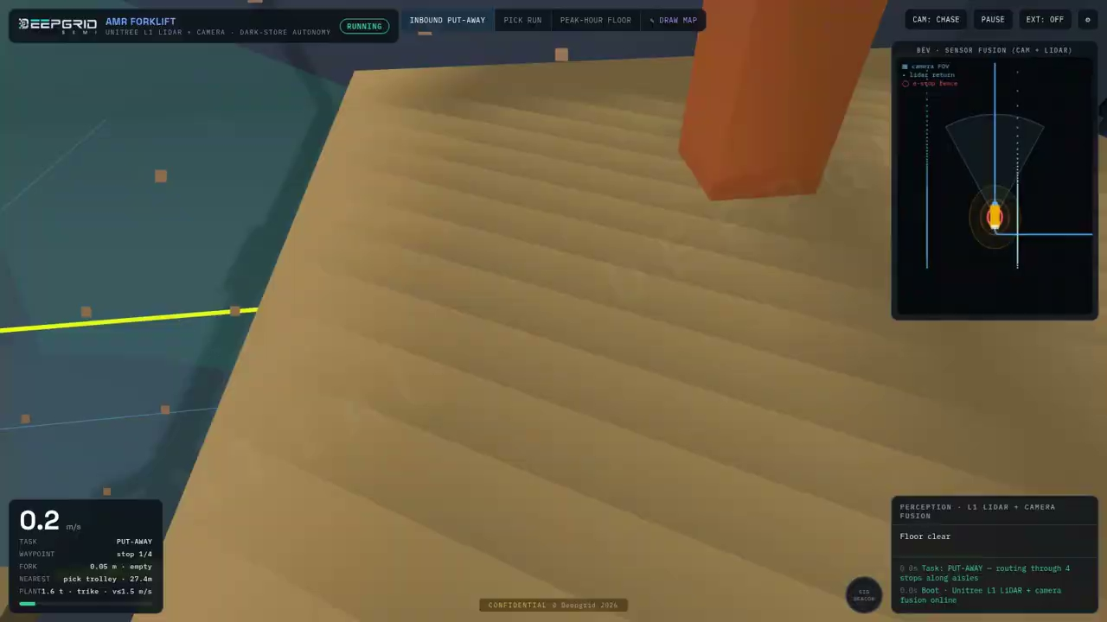
AD1 INDOOR L4 KIT · F
The simulator, running
Dark-store AMR sim, recorded running. Inbound put-away, then a pick run, then the peak-hour floor.
The route
Waypoints snap to aisles; the vehicle drives them, not an animation path.
The safety ring
A geofenced zone travels with the truck and gates its speed.
The hazards
Workers, peer AMRs, trolleys and spills must all be resolved, not dodged by luck.
The peak floor
The third scenario decides whether a site can actually run this.
Recorded from the simulator itself; the clip plays in the deck. Simulation, not a fielded deployment.
DEEPGRID SEMI · PRODUCT LINES · MANAGEMENT PROJECTIONS
17
Notes:
[Sources]
Original simulator recording: C:/Users/sheke/Downloads/DeepGrid-Sim-Clips/forklift.mp4
Private Drive video: https://drive.google.com/file/d/1TEI3mDm8JoUZfyT-_YICbumwHoBhIb4p/view?usp=drivesdk
Simulation, not field validation. Video audio muted to prevent non-Holt or duplicate narration; custom Holt voiceover belongs in Google Vids.
[/Sources]
AD1 Indoor L4 kit — embedded clip of AMR Forklift · Dark-Store Sim. The route: Waypoints snap to aisles; the vehicle drives them, not an animation path. The safety ring: A geofenced zone travels with the truck and gates its speed. The hazards: Workers, peer AMRs, trolleys and spills must all be resolved, not dodged by luck. The peak floor: The third scenario decides whether a site can actually run this.

Slide 18
SMART TRUCK (AD2 KIT) · A
What it is
A commercial-vehicle ADAS kit: forward camera, radar, compute box, driver display and harness.
₹2.50 L
Systems
Outdoor
FY2027
UNIT PRICE
SEGMENT
OPERATING DOMAIN
FIRST REVENUE
WHAT IS IN IT
01
02
03
04
Forward camera and 4D radar
SoC2 compute box
Driver interface display and alert
Vehicle bus harness and brake interface
How it is positioned
Smart Truck (AD2 kit) sells at ₹2.50 L into the road autonomy surface. The largest SKU in the plan at ₹450 Cr and the reason the portfolio has a demand floor rather than a demand forecast.
DEEPGRID SEMI · PRODUCT LINES · MANAGEMENT PROJECTIONS
18
Notes:
Smart Truck (AD2 kit) — what it is. Price ₹2.50 L, segment Systems, domain Outdoor, first revenue FY2027.

Slide 19
SMART TRUCK (AD2 KIT) · B
How it works
Sense, compute on SoC2, decide, act — the same four stages in every product.
SIGNAL CHAIN
1
Camera and radar watch the forward path and the blind quarters
2
SoC2 fuses both into one object list with range and closing speed
3
Collision, lane and blind-spot logic decide whether to warn
4
Driver is warned, and the brake interface is signalled where fitted
What the silicon does here
What this product depends on
The box takes eleven channels at once — seven 8MP RGB cameras on GMSL2, two thermal and front/rear 4D 77 GHz radar — and fuses the whole suite in 8.6 ms of a 33.3 ms frame. That leaves 74% of the frame budget unused, which is the margin that lets one part serve every sensor configuration below it.
Certification through ARAI or ICAT, and installation capacity at 18,000 fitments a year.
DEEPGRID SEMI · PRODUCT LINES · MANAGEMENT PROJECTIONS
19
Notes:
Smart Truck (AD2 kit) — signal chain: Camera and radar watch the forward path and the blind quarters -> SoC2 fuses both into one object list with range and closing speed -> Collision, lane and blind-spot logic decide whether to warn -> Driver is warned, and the brake interface is signalled where fitted. Depends on: Certification through ARAI or ICAT, and installation capacity at 18,000 fitments a year.

Slide 20
SMART TRUCK (AD2 KIT) · C
Who buys it, and why now
Regulatory. Driver-drowsiness, blind-spot and lane-departure obligations on N2/N3 vehicles.
The buyer
The channel
Fleet operators and truck OEMs — the decision is compliance-led, not discretionary.
Fleet direct and retrofit installers, with OEM line-fit as the longer route.
Demand pool · 1.80% capture at FY2032
MANDATORY: 0.5M new N2/N3 trucks/yr + 0.5M retrofit. Our FY2032 volume of 18,000 units is 1.80% of that pool.
Source: MoRTH GSR 184(E) ADAS mandate on N2/N3. Capture rates are management assumptions; pool sizes are third-party published estimates.
DEEPGRID SEMI · PRODUCT LINES · MANAGEMENT PROJECTIONS
20
Notes:
Smart Truck (AD2 kit) — buyer: Fleet operators and truck OEMs — the decision is compliance-led, not discretionary. Channel: Fleet direct and retrofit installers, with OEM line-fit as the longer route. Trigger: Regulatory. Driver-drowsiness, blind-spot and lane-departure obligations on N2/N3 vehicles. Pool: MANDATORY: 0.5M new N2/N3 trucks/yr + 0.5M retrofit (1.80%). Source: MoRTH GSR 184(E) ADAS mandate on N2/N3.

Slide 21
SMART TRUCK (AD2 KIT) · D
How it fits the overall picture
₹450 Cr at FY2032 — 39.9% of group revenue, at 89% gross margin.
18,000
₹450 Cr
39.9%
89%
FY2032 UNITS
FY2032 REVENUE
SHARE OF GROUP
GROSS MARGIN
UNITS SHIPPED
REVENUE, ₹ CR
18,000
450
9,000
225
3
80
1,400
4,000
0
2
35
100
FY27
FY28
FY29
FY30
FY31
FY32
FY27
FY28
FY29
FY30
FY31
FY32
Its role in the portfolio
What it depends on
The largest SKU in the plan at ₹450 Cr and the reason the portfolio has a demand floor rather than a demand forecast.
Certification through ARAI or ICAT, and installation capacity at 18,000 fitments a year.
DEEPGRID SEMI · PRODUCT LINES · MANAGEMENT PROJECTIONS
21
Notes:
Smart Truck (AD2 kit) — units 3 / 80 / 1400 / 4000 / 9000 / 18000, revenue 0.07 / 2 / 35 / 100 / 225 / 450 ₹Cr. FY2032 ₹450 Cr = 39.88% at 89%. Role: The largest SKU in the plan at ₹450 Cr and the reason the portfolio has a demand floor rather than a demand forecast.

Slide 22
SMART TRUCK (AD2 KIT) · E
Proven in a working simulator
Bird’s-eye planner view over camera, radar and LiDAR, on a live vehicle-dynamics model
LIVE DEMONSTRATOR
D-DRIVE · ADAS Sim v2
Three road profiles
Real plant model
Market street, single-carriageway highway and a stress-test scenario run against the same perception stack.
550 kg mass, 2.10 m wheelbase, μ 0.75 tyre friction — steering angle and lateral acceleration are solved, not scripted.
Perception, not replay
Why it matters
Targets enter and leave the corridor from the sensor model; the planner view redraws from the fused object list.
It shows the decision layer a buyer is actually purchasing, before any truck is fitted.
The demonstrator runs the production perception stack against a simulated environment. It is evidence of the decision layer, not of a fielded deployment.
DEEPGRID SEMI · PRODUCT LINES · MANAGEMENT PROJECTIONS
22
Notes:
Smart Truck (AD2 kit) — demonstrator D-DRIVE · ADAS Sim v2. Three road profiles: Market street, single-carriageway highway and a stress-test scenario run against the same perception stack. Real plant model: 550 kg mass, 2.10 m wheelbase, μ 0.75 tyre friction — steering angle and lateral acceleration are solved, not scripted. Perception, not replay: Targets enter and leave the corridor from the sensor model; the planner view redraws from the fused object list. Why it matters: It shows the decision layer a buyer is actually purchasing, before any truck is fitted.

Slide 23
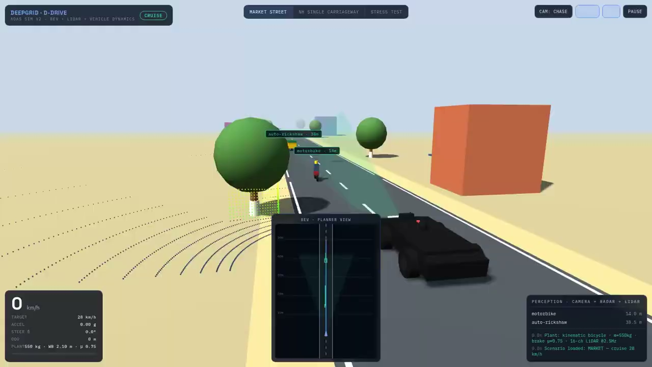
SMART TRUCK (AD2 KIT) · F
The simulator, running
D-DRIVE ADAS Sim v2, recorded running. Market street, then highway, then the stress-test scenario.
The planner view
The BEV panel redraws from the fused object list, not from a script.
The perception rail
Named classes with live range — motorbike and auto-rickshaw, metres out.
The plant readout
550 kg, 2.10 m wheelbase, μ 0.75. Steering and lateral g are solved.
The scenario switch
Same stack, three road profiles. Nothing is reloaded between them.
Recorded from the simulator itself; the clip plays in the deck. Simulation, not a fielded deployment.
DEEPGRID SEMI · PRODUCT LINES · MANAGEMENT PROJECTIONS
23
Notes:
[Sources]
Original simulator recording: C:/Users/sheke/Downloads/DeepGrid-Sim-Clips/ddrive.mp4
Private Drive video: https://drive.google.com/file/d/1uuQq6qOYzvAVWjskI5XPwN-uU-6xz09a/view?usp=drivesdk
Simulation, not field validation. Video audio muted to prevent non-Holt or duplicate narration; custom Holt voiceover belongs in Google Vids.
[/Sources]
Smart Truck (AD2 kit) — embedded clip of D-DRIVE · ADAS Sim v2. The planner view: The BEV panel redraws from the fused object list, not from a script. The perception rail: Named classes with live range — motorbike and auto-rickshaw, metres out. The plant readout: 550 kg, 2.10 m wheelbase, μ 0.75. Steering and lateral g are solved. The scenario switch: Same stack, three road profiles. Nothing is reloaded between them.

Slide 24
SMART TRUCK · SENSOR TO COMPUTE
Eleven inputs, one compute product
Seven RGB cameras, two thermal cameras and two radars converge on the in-cab processor.
7 colour cameras
Road left/right, side left/right, dashcam, driver and rear.
7 RGB cameras
IN-CAB
COMPUTE
Fused
perception
2 thermal cameras
2 thermal cameras
An additional sensing modality in the two mirror towers.
2 radars
2 radars
Front and rear range and relative-motion inputs.
The reusable product
11 configured inputs → one perception platform
Compute and software; the installation is one application.
Architecture illustration. Targets and arithmetic peaks require workload and implementation validation.
DEEPGRID SEMI · PRODUCT LINES · MANAGEMENT PROJECTIONS
24
Notes:
The product story starts with the compute box, not the mirrors. The proposed configuration has eleven inputs: seven colour cameras, two thermal cameras and two radars. The colour cameras cover the left and right road views, both truck sides, a forward dashcam, the driver and the rear. Two thermal cameras add another sensing modality. Front and rear radar contribute range and velocity. These inputs converge on the in-cab processor for fused perception. For an investor, the distinction matters: the proposed semiconductor and software platform is the reusable product; the sensor installation is one application of it. The illustrated configuration is not, by itself, evidence that the entire suite has been validated together.
[Sources]
Speciale product section 02a, lines 427–527. Investor implication: reusable compute platform versus installation-specific sensor integration.
User-supplied Deepgrid_Speciale_Deck (1).html and Deepgrid_DataMovement.html. Illustrative architecture, not independently measured silicon evidence.
[/Sources]

Slide 25
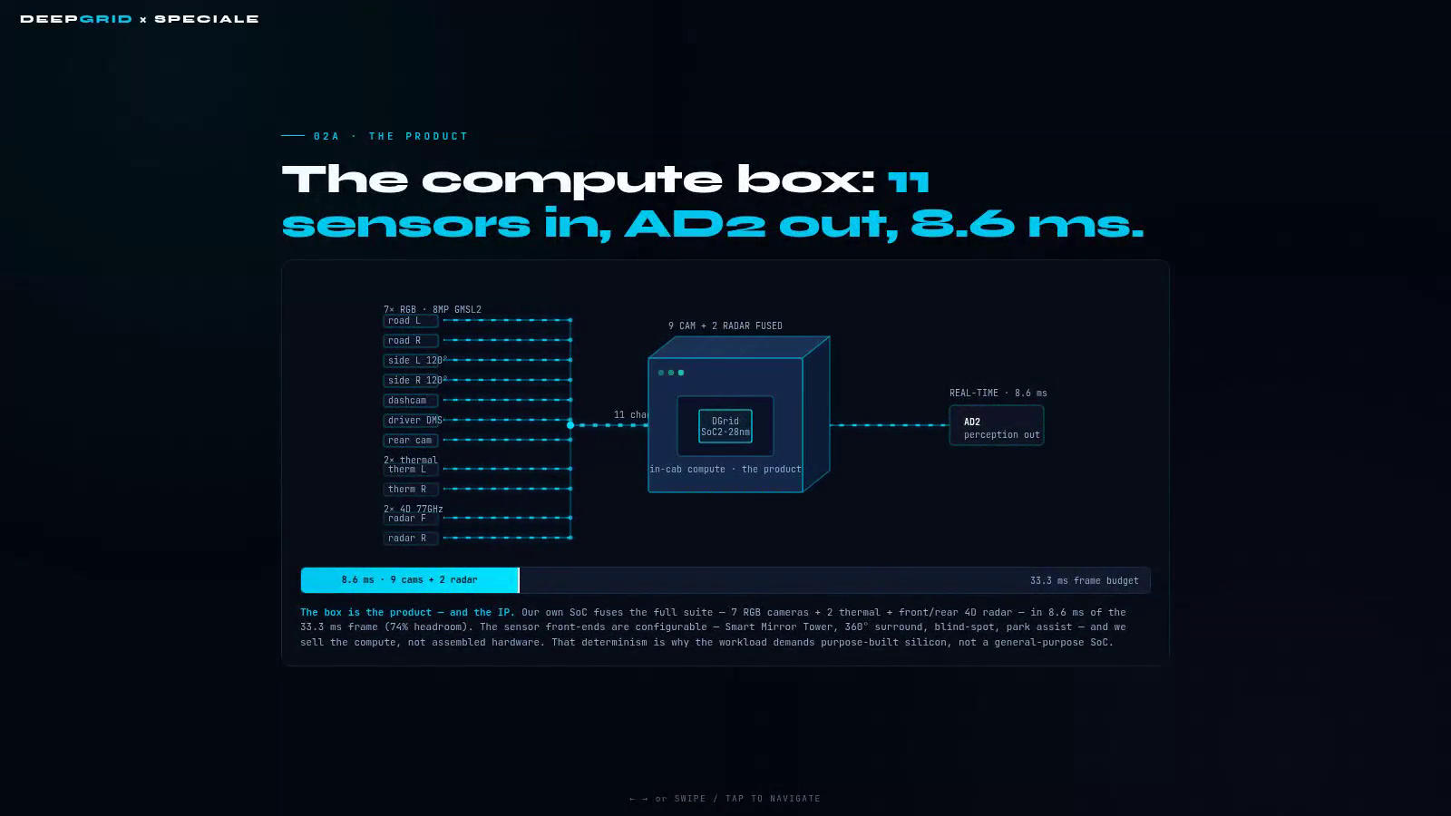
See eleven inputs become one AD2 output
Illustrative sensor-fusion timing—not a measured production latency.
Click the video to play · Narrated · No music

Slide 26
SMART TRUCK · SENSOR TO COMPUTE
Each sensor has a distinct job
Complementary views explain the intended coverage—not proven absence of blind spots.
Mirror towers
Front radar
Road, 120° side and thermal cameras on each side.
Left tower
road + side + thermal
CAB
dashcam + DMS
Right tower
road + side + thermal
Vehicle front and rear
Radar at both ends; a rear camera covers behind the truck.
VEHICLE
coverage zones
Inside the cab
Dashcam recording and driver monitoring are distinct tasks.
Rear camera + radar
Integration to confirm
Calibration, occlusion, mounting and the final sensor list.
Schematic placement; calibration and occlusion require testing
Architecture illustration. Targets and arithmetic peaks require workload and implementation validation.
DEEPGRID SEMI · PRODUCT LINES · MANAGEMENT PROJECTIONS
25
Notes:
Each mirror tower combines a road-facing camera, a one hundred and twenty degree side camera and a thermal camera. The placement is intended to complement the truck's existing mirrors. The rear camera covers directly behind the vehicle and the rear-side areas, while radar adds distance and relative-motion information at both ends. Inside the cab, the dashcam records the road and the driver-monitoring camera watches the driver. The schematic shows how these sensing roles complement each other. Overlap explains the intended design; it does not prove zero blind spots. Occlusion, calibration, mounting tolerance and environmental testing still determine actual coverage. The proposed installation also includes six ultrasonic sensors outside the headline eleven-input count, so the production sensor bill of materials needs reconciliation.
[Sources]
Speciale 02b, lines 533–635. Do not repeat the absolute headline “zero blind spots” as a verified outcome.
User-supplied Deepgrid_Speciale_Deck (1).html and Deepgrid_DataMovement.html. Illustrative architecture, not independently measured silicon evidence.
[/Sources]

Slide 27
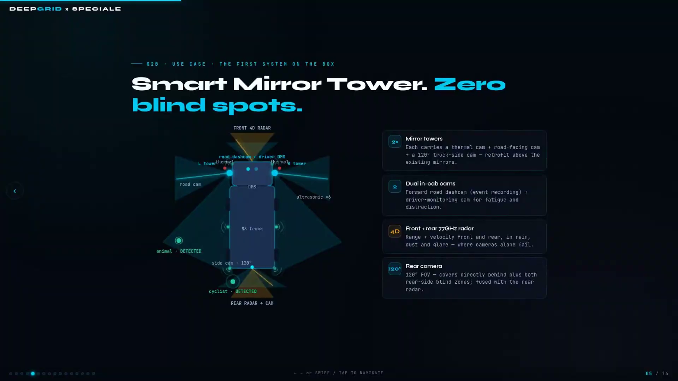
See the truck’s complementary sensor views
Illustrative sensor coverage—not evidence of zero blind spots or field validation.
Click the video to play · Narrated · No music
Notes:
[Sources]
Existing truck-clean-narrated.mp4 from the DeepGrid video project, based on user-supplied Deepgrid_Speciale_Deck (1).html. Google Drive media: 1bP9Cm2wKVLO_GvymplTuob8XN78D20aB. Existing Holt narration retained; no music added. Animated design illustration, not validated coverage or field performance. Original HTML claims inside the clip are not independently verified.
[/Sources]

Slide 28
SMART TRUCK · SENSOR TO COMPUTE
Define the latency measurement
The 8.6 ms processing claim must be tied to a reproducible end-to-end workload.
33.3 ms frame budget
The reference budget corresponds to approximately 30 frames per second.
Acquire
Process
Fuse
Output
8.6 ms claimed work
33.3 ms frame budget
Confirm which acquisition, inference and fusion stages it includes.
8.6 ms
24.7 ms arithmetic remainder
24.7 ms remainder
Budget subtraction, not measured system headroom.
Claimed processing slice ≠ validated end-to-end latency
No per-stage timings are inferred
Evidence required
Precision, power, sustained rate and worst-case latency.
Architecture illustration. Targets and arithmetic peaks require workload and implementation validation.
DEEPGRID SEMI · PRODUCT LINES · MANAGEMENT PROJECTIONS
26
Notes:
Management reports eight point six milliseconds for the fused sensor workload against a thirty-three point three millisecond frame budget. On paper, that leaves twenty-four point seven milliseconds, or about seventy-four percent of the frame. That is useful budget arithmetic, not independently demonstrated system headroom. The measurement boundary matters: acquisition, preprocessing, inference, fusion, output and worst-case delay may not all be included in one number. Management also gives a six-camera-plus-radar, whole-frame performance target. Those scopes cannot be assumed identical. The investor question is therefore practical: can the team reproduce the complete workload, at stated precision and power, with worst-case latency and sustained throughput measured on the intended hardware?
[Sources]
Speciale 02a, 04 and 05. Do not equate 8.6 ms with the source's separate ~41 fps whole-frame target.
User-supplied Deepgrid_Speciale_Deck (1).html and Deepgrid_DataMovement.html. Illustrative architecture, not independently measured silicon evidence.
[/Sources]

Slide 29
SMART TRUCK · SENSOR TO COMPUTE
Prove the production system in stages
FPGA demonstrations, ASIC verification and vehicle qualification answer different questions.
FPGA demonstration
Exercise the software, interfaces and prototype compute.
FPGA
demonstration
ASIC
verification
Vehicle
qualification
Production ASIC
Verify scaled compute, memory, clock, power and area together.
Workload + interfaces
Clock + power + area
Safety + environment
Vehicle integration
Test thermal behaviour, safety path and operational conditions.
Release confidence against evidence at every stage
Capital-release gate
Reproducible measurements on the intended configuration.
Architecture illustration. Targets and arithmetic peaks require workload and implementation validation.
DEEPGRID SEMI · PRODUCT LINES · MANAGEMENT PROJECTIONS
27
Notes:
The development plan draws a distinction between the existing F P G A platform and the proposed production A S I C. It describes A D zero and A D one capabilities on F P G A, while the A D two production case depends on SoC two. The roadmap also describes a cube prototype on F P G A; the production challenge is therefore not simply drawing a cube. It is integrating the scaled compute, memory movement, software and safety architecture within the required area, clock and power. Treat the software demonstration as an explanation of the system. Release confidence in stages: reproducible hardware measurements, a frozen production specification, silicon bring-up, and then vehicle-level validation. None of those stages is replaced by an attractive animation.
[Sources]
Speciale 03–05 and diligence section 10. Avoid repeating revenue, regulatory exclusivity or fundraising assertions in this technical insert.
User-supplied Deepgrid_Speciale_Deck (1).html and Deepgrid_DataMovement.html. Illustrative architecture, not independently measured silicon evidence.
[/Sources]

Slide 30
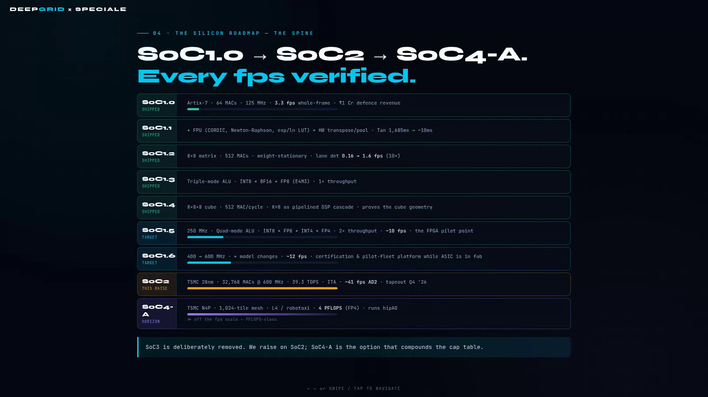
See every generation proven at a measured frame rate
Illustrative roadmap animation—frame rates are management figures, not third-party benchmarks.
Click the video to play · Narrated · No music

Slide 31
PART TWO
Silicon & compute
₹194 Cr · 17.2% of FY2032 · 5 SKUs · Selling the chip, not the vehicle
DEEPGRID SEMI · PRODUCT LINES · MANAGEMENT PROJECTIONS
28
Notes:
Silicon & compute: Chipset OEM B2B (ASIC die), A100 compute box 1ch +SDK (M.2), A100 compute box 2ch +SDK, A100 compute box 4ch +SDK (PCIe), T100 AI licence (SaaS).

Slide 32
CHIPSET OEM B2B · A
What it is
The bare SoC2 die, supplied in tray or reel for the customer to place on their own board.
₹18,000
Semiconductors
Outdoor
FY2028
UNIT PRICE
SEGMENT
OPERATING DOMAIN
FIRST REVENUE
WHAT IS IN IT
01
02
03
SoC2 die, tested and binned
Reference design and integration documentation
Toolchain access and support
How it is positioned
Chipset OEM B2B (ASIC die) sells at ₹18,000 into the silicon & compute surface. The most profitable revenue in the plan at 94% margin, needing no integration, certification or installation capacity from us.
DEEPGRID SEMI · PRODUCT LINES · MANAGEMENT PROJECTIONS
29
Notes:
Chipset OEM B2B (ASIC die) — what it is. Price ₹18,000, segment Semiconductors, domain Outdoor, first revenue FY2028.

Slide 33
CHIPSET OEM B2B · B
How it works
Sense, compute on SoC2, decide, act — the same four stages in every product.
SIGNAL CHAIN
1
The customer's own sensors feed their own board
2
The SoC2 die does the perception compute inside their design
3
Their software decides what to do with the result
4
Their product ships, with our silicon inside it
What the silicon does here
What this product depends on
This is the die itself: TSMC 28 nm, roughly 57 mm², 32,768 MACs at 600 MHz for 39.3 TOPS, against 102.4 GB/s of dual-channel LPDDR5. Sold as silicon, so the buyer builds their own board and carries their own integration.
Working, qualified silicon. Every unit of this line is downstream of the tapeout landing.
DEEPGRID SEMI · PRODUCT LINES · MANAGEMENT PROJECTIONS
30
Notes:
Chipset OEM B2B (ASIC die) — signal chain: The customer's own sensors feed their own board -> The SoC2 die does the perception compute inside their design -> Their software decides what to do with the result -> Their product ships, with our silicon inside it. Depends on: Working, qualified silicon. Every unit of this line is downstream of the tapeout landing.

Slide 34
CHIPSET OEM B2B · C
Who buys it, and why now
Wanting Indian-designed silicon and domestic supply rather than an imported module.
The buyer
The channel
Tier-1 suppliers and OEMs with in-house hardware teams.
Direct design-in engagements, long cycle, high commitment.
Demand pool · 0.25% capture at FY2032
India ADAS chip pool; $2.29B ADAS (2024). Our FY2032 volume of 30,000 units is 0.25% of that pool.
Source: EMR 2024: $2.29B, 20.6% CAGR. Capture rates are management assumptions; pool sizes are third-party published estimates.
DEEPGRID SEMI · PRODUCT LINES · MANAGEMENT PROJECTIONS
31
Notes:
Chipset OEM B2B (ASIC die) — buyer: Tier-1 suppliers and OEMs with in-house hardware teams. Channel: Direct design-in engagements, long cycle, high commitment. Trigger: Wanting Indian-designed silicon and domestic supply rather than an imported module. Pool: India ADAS chip pool; $2.29B ADAS (2024) (0.25%). Source: EMR 2024: $2.29B, 20.6% CAGR.

Slide 35
CHIPSET OEM B2B · D
How it fits the overall picture
₹54.0 Cr at FY2032 — 4.8% of group revenue, at 94% gross margin.
30,000
₹54.0 Cr
4.8%
94%
FY2032 UNITS
FY2032 REVENUE
SHARE OF GROUP
GROSS MARGIN
UNITS SHIPPED
REVENUE, ₹ CR
30,000
54
15,000
27
0
30
1,750
6,000
0
0
3
11
FY27
FY28
FY29
FY30
FY31
FY32
FY27
FY28
FY29
FY30
FY31
FY32
Its role in the portfolio
What it depends on
The most profitable revenue in the plan at 94% margin, needing no integration, certification or installation capacity from us.
Working, qualified silicon. Every unit of this line is downstream of the tapeout landing.
DEEPGRID SEMI · PRODUCT LINES · MANAGEMENT PROJECTIONS
32
Notes:
Chipset OEM B2B (ASIC die) — units 0 / 30 / 1750 / 6000 / 15000 / 30000, revenue 0 / 0.05 / 3.15 / 10.8 / 27 / 54 ₹Cr. FY2032 ₹54.0 Cr = 4.79% at 94%. Role: The most profitable revenue in the plan at 94% margin, needing no integration, certification or installation capacity from us.

Slide 36
CHIPSET OEM · COMPUTE AND DATA MOVEMENT
Compute waits when data queues
Local dispatch removes a shared controller bottleneck; physical memory remains finite.
SHARED DISPATCH
Shared data engine
Eight processing cores queue behind one dispatch point.
1
2
3
4
5
6
7
8
Local DMA proposal
ONE DATA ENGINE
Each core generates addresses and dispatches transfers independently.
LOCAL DISPATCH
Shared memory banks
Parallel requests still compete for service capacity.
D1
D2
D3
D4
D5
D6
D7
D8
Independent requests → finite shared bank service
Estimate, not a result
470 ms → 85 ms is a proposal awaiting testbench evidence.
Architecture illustration. Targets and arithmetic peaks require workload and implementation validation.
DEEPGRID SEMI · PRODUCT LINES · MANAGEMENT PROJECTIONS
33
Notes:
More arithmetic units do not help when those units are waiting for data. The first demonstration shows eight processing cores sharing one data-movement engine. Requests queue at that common point. The proposed change gives each core a local direct-memory-access engine, so address generation and dispatch can proceed independently. That removes one source of serialization, but it does not create unlimited memory bandwidth. The next constraint is whether the shared memory banks can actually serve those requests. The page includes an estimate of a four-hundred-and-seventy millisecond frame falling to roughly eighty-five milliseconds. It labels that work as a proposal awaiting testbench evidence. We use the animation to explain the bottleneck, not to promote that estimate into a measured speedup.
[Sources]
DataMovement #problem, including its paper-design/testbench disclaimer.
User-supplied Deepgrid_Speciale_Deck (1).html and Deepgrid_DataMovement.html. Illustrative architecture, not independently measured silicon evidence.
[/Sources]

Slide 37
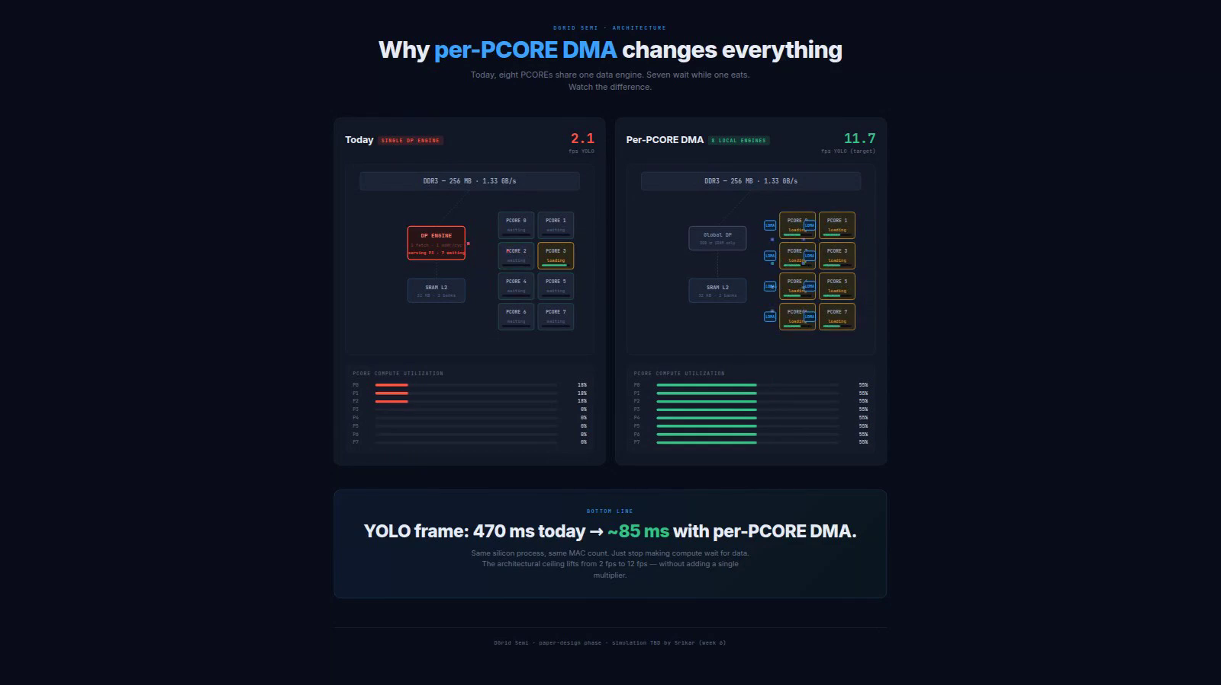
See what a shared data engine costs
Illustrative dispatch comparison—not a measured application speedup.
Click the video to play · Narrated · No music

Slide 38
CHIPSET OEM · COMPUTE AND DATA MOVEMENT
A local DMA keeps a core supplied
A descriptor becomes an address sequence, then a buffered stream into compute.
16-entry descriptor table
16-entry descriptor table
Transfer parameters identify the data layout and request.
1
2
3
4
5
6
7
8
3-level
address
generator
Read
FIFO
9
10
11
12
13
14
15
16
Three-level address engine
Walks the tensor layout without central dispatch for every transfer.
Read FIFO
Idle
Load
Compute
Buffers arrivals between memory service and compute consumption.
Implementation estimate
Hardware controllers also need compiler and arbitration support
~600 LUTs each; ~4,800 for eight, plus arbitration and software.
Architecture illustration. Targets and arithmetic peaks require workload and implementation validation.
DEEPGRID SEMI · PRODUCT LINES · MANAGEMENT PROJECTIONS
34
Notes:
A local D M A is a small controller that keeps a core supplied. The proposal gives it a sixteen-entry descriptor table, a three-level address generator and a read F I F O. The descriptor describes the transfer. Address generation walks the required data layout. The F I F O buffers arrivals so computation does not have to track every memory transaction directly. The page estimates about six hundred F P G A lookup tables per local engine, or about four thousand eight hundred for eight engines, before additional arbitration. It also describes firmware and compiler changes and a sixteen-to-twenty-four week implementation effort. Those are engineering estimates, not a finished implementation or a production cost quote.
[Sources]
DataMovement #problem and #destination LDMA detail. Keep LUT estimates distinct from ASIC area or cost.
User-supplied Deepgrid_Speciale_Deck (1).html and Deepgrid_DataMovement.html. Illustrative architecture, not independently measured silicon evidence.
[/Sources]

Slide 39
CHIPSET OEM · COMPUTE AND DATA MOVEMENT
Data placement is an architectural choice
The useful comparison is who schedules movement, where data resides and what crosses the chip.
Shared dispatch
A common engine schedules movement for several cores.
Shared
dispatch
Local / clustered
movement
Distributed
storage
Local or clustered movement
Controllers issue requests nearer the compute they serve.
Common scheduling
point
Requests near
compute
Locality with
coordination
Distributed storage
More data resides locally; software must map and coordinate it.
Conceptual examples: DeepGrid, EyeQ, Orin, Hailo, Dojo
Differentiation to prove
Implementations differ; this is not a competitive benchmark
Workload results, compiler mapping and implementation IP—not DMA alone.
Architecture illustration. Targets and arithmetic peaks require workload and implementation validation.
DEEPGRID SEMI · PRODUCT LINES · MANAGEMENT PROJECTIONS
35
Notes:
The second demonstration places the decision on a broader memory-architecture map. It contrasts shared dispatch, local or clustered data movement, and more distributed memory. The page uses Mobileye, Nvidia, Hailo and Dojo as examples, alongside DeepGrid's current and proposed arrangements. These are simplified analogies, not identical architectures or a validated competitive ranking. Peak operations per second and power figures from different products cannot be compared without workload, precision and system boundaries. The useful investor point is narrower: local data movement is an established design direction. DeepGrid's differentiation would need to appear in its implementation, software mapping, application results and defensible intellectual property—not in the generic presence of D M A alone.
[Sources]
DataMovement #landscape and its comparison disclaimer. Do not import unverified contemporary vendor or project-status assertions.
User-supplied Deepgrid_Speciale_Deck (1).html and Deepgrid_DataMovement.html. Illustrative architecture, not independently measured silicon evidence.
[/Sources]

Slide 40
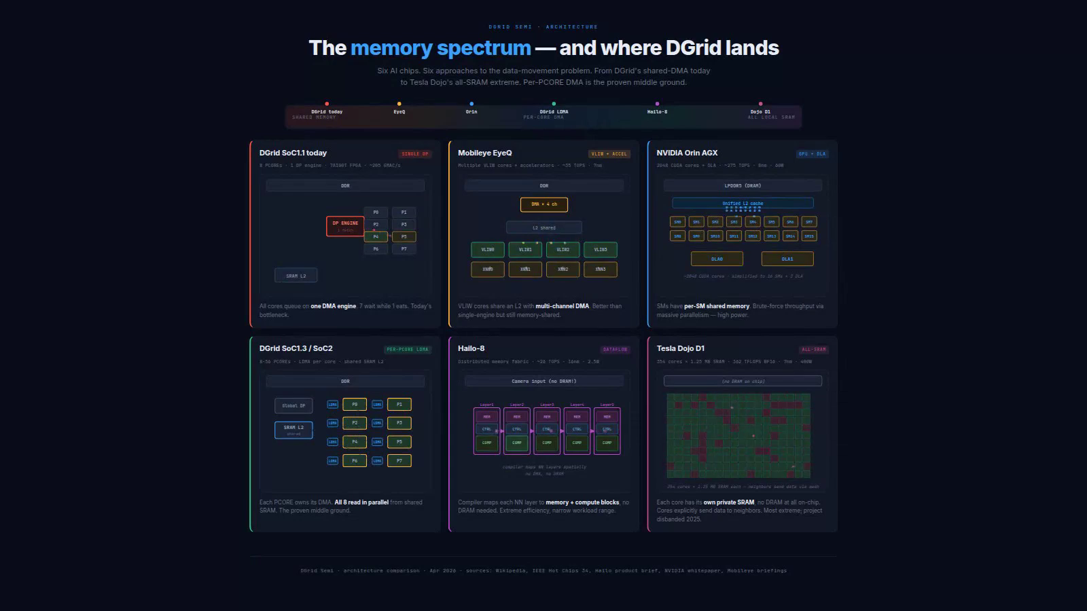
See where DGrid sits on the memory spectrum
Illustrative architecture comparison—vendor figures from public sources.
Click the video to play · Narrated · No music

Slide 41
CHIPSET OEM · COMPUTE AND DATA MOVEMENT
Eight layers explain the arithmetic peak
64 versus 512 multiply-accumulate positions: an idealized K = 8 comparison, not application speedup.
Flat 8 × 8
8 × 8 FLAT
8 × 8 × 8 CUBE
64 MAC positions; the reduction depth is processed across iterations.
Cube 8 × 8 × 8
8 layers
512 MAC positions; reduction depth is expressed in hardware.
Same illustrative tile
Compare the same K = 8 workload and stated precision.
64 MACs / cycle
512 MACs / cycle
System-level limits
Same K = 8 tile; idealized arithmetic, not application speedup
Pipeline fill, tensor shapes, reuse and memory delivery still matter.
Architecture illustration. Targets and arithmetic peaks require workload and implementation validation.
DEEPGRID SEMI · PRODUCT LINES · MANAGEMENT PROJECTIONS
36
Notes:
Now separate compute geometry from the memory system. An eight-by-eight matrix contains sixty-four multiply-accumulate positions. Stacking eight such layers creates five hundred and twelve positions. In the page's idealized comparison, the flat unit iterates through a reduction depth of eight, while the cube expresses that depth in hardware. That is the origin of the eight-times arithmetic comparison. It is not a promise that an entire neural network runs eight times faster. Pipeline fill, tensor shape, supported precision, data reuse and memory delivery all matter. The flat and cube diagrams should therefore process the same illustrative tile, with the assumptions visible, so the viewer can see exactly what is—and is not—being compared.
[Sources]
DataMovement #roadmap, Chapter A; Speciale 05b.
User-supplied Deepgrid_Speciale_Deck (1).html and Deepgrid_DataMovement.html. Illustrative architecture, not independently measured silicon evidence.
[/Sources]

Slide 42
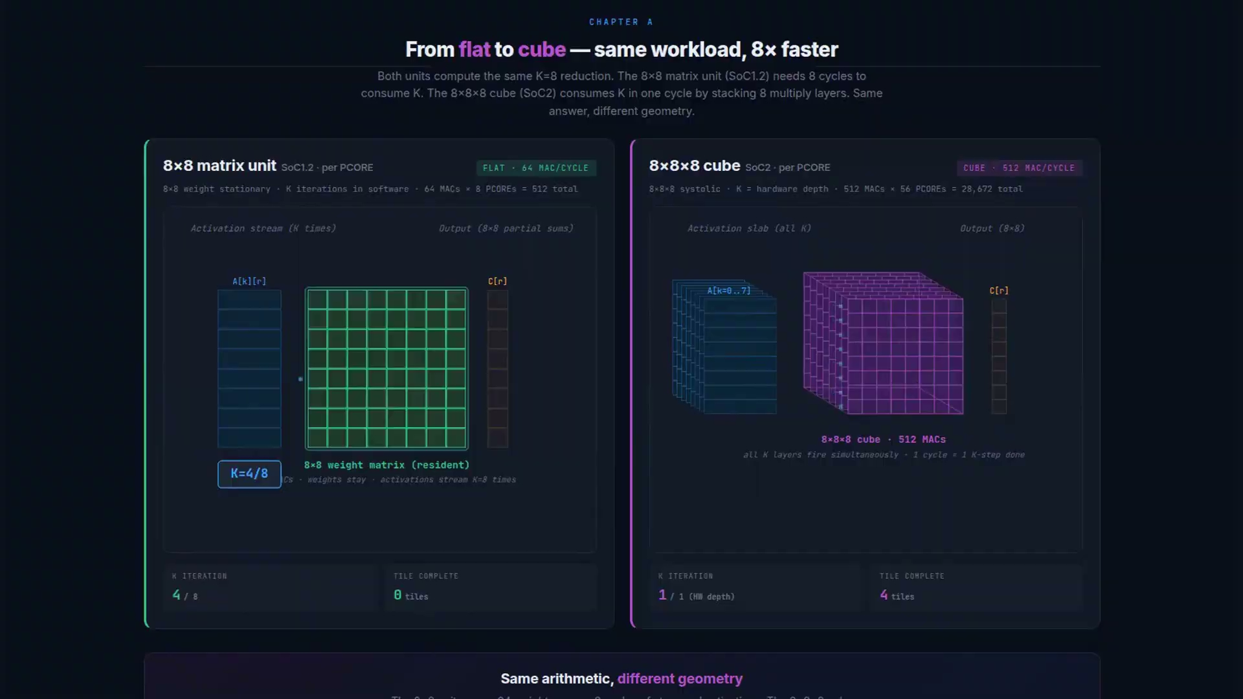
See the flat-to-cube compute comparison
Illustrative arithmetic demonstration—not a measured application speedup.
Click the video to play · Narrated · No music
Notes:
[Sources]
Existing cube-clean-narrated.mp4 from the DeepGrid video project, based on user-supplied Deepgrid_DataMovement.html. Google Drive media: 1eMvcW8gecsgCc8Tvbw9PddLOUUGS-DRL. Existing Holt narration retained; no music added. The K=8 comparison illustrates idealized arithmetic; it is not an application benchmark or validated silicon throughput.
[/Sources]

Slide 43
CHIPSET OEM · COMPUTE AND DATA MOVEMENT
More arithmetic needs a stronger data path
Compute geometry, data movement and physical implementation must be designed together.
Compute geometry
Additional arithmetic increases the potential demand for data.
COMPUTE
DISPATCH
MEMORY
Local dispatch
Independent controllers remove one serialization point.
Available MACs
Issued requests
Served requests
Bank service
Peak capacity
Useful sustained work
Memory mapping and arbitration determine which requests complete.
Tensor layout + reuse + bank conflicts + implementation limits
Sustained performance
Queueing and stalls must be measured under representative load
Measure useful work; peak TOPS alone does not show utilization.
Architecture illustration. Targets and arithmetic peaks require workload and implementation validation.
DEEPGRID SEMI · PRODUCT LINES · MANAGEMENT PROJECTIONS
37
Notes:
The next challenge is the feeding problem. A cube increases the amount of arithmetic available each cycle, so the surrounding data path must keep it supplied. The source couples three decisions: flat-to-cube compute, shared-to-local D M A, and an implementation that can meet the area, power and clock requirements. Its stated bytes-per-cycle requirement is an illustrative workload assumption; actual external traffic also depends on precision and data reuse. Adding local controllers addresses dispatch, while banked memory and scheduling address service capacity. Utilization estimates need a repeatable workload and an explicit bank scheduler before they can be treated as hardware results. Queueing, dispatch and bank service are separate dependencies that need to be measured.
[Sources]
DataMovement #roadmap, Chapter B; see SOURCE-AUDIT.md for the scheduler discrepancy.
User-supplied Deepgrid_Speciale_Deck (1).html and Deepgrid_DataMovement.html. Illustrative architecture, not independently measured silicon evidence.
[/Sources]

Slide 44
CHIPSET OEM · COMPUTE AND DATA MOVEMENT
Follow a tile through the complete system
56 local requesters share eight L2 banks and an external-memory path.
Global path
DDR
Global data path
Shared L2
External memory feeds the shared on-chip storage.
8 shared memory banks
Eight L2 banks
B0
B1
B2
B3
B4
B5
B6
B7
Requests are served according to mapping and arbitration.
56 local DMA + cube pairs · highlighted tile to core 1
1
2
3
4
5
6
7
8
56 local engines
9
10
11
12
13
14
15
16
Each local DMA supplies its associated compute cube.
17
18
19
20
21
22
23
24
25
26
27
28
29
30
31
32
33
34
35
36
37
38
39
40
41
42
43
44
45
46
47
48
34.4 TOPS arithmetic peak
49
50
51
52
53
54
55
56
56 × 512 MACs × 600 MHz × 2 operations; not a benchmark.
56 × 512 × 600 MHz × 2 = 34.4064 TOPS arithmetic peak
Architecture illustration. Targets and arithmetic peaks require workload and implementation validation.
DEEPGRID SEMI · PRODUCT LINES · MANAGEMENT PROJECTIONS
38
Notes:
The destination animation uses fifty-six cores, each with a five-hundred-and-twelve-position cube and a local D M A. Data moves from external memory through the global path into eight banks of shared level-two memory, then into the local engines and compute units. At six hundred megahertz, counting a multiply and an addition as two operations, the arithmetic peak is thirty-four point four T O P S. That is a mathematical ceiling, not a measured application result. Eight banks also do not mean fifty-six independent memory services in the same cycle. The point of the system view is to make those shared resources visible, including the possibility that the external path becomes the next bottleneck.
[Sources]
DataMovement #destination. Mathematical check: 56 × 512 × 600e6 × 2 / 1e12 = 34.4064.
User-supplied Deepgrid_Speciale_Deck (1).html and Deepgrid_DataMovement.html. Illustrative architecture, not independently measured silicon evidence.
[/Sources]

Slide 45
CHIPSET OEM · COMPUTE AND DATA MOVEMENT
A hot bank can stall the whole array
Hold the workload constant: spread requests, collide on one bank, then restore distribution.
Spread
56 requests distributed evenly give seven requests per bank.
SPREAD
7
7
7
7
7
7
7
7
B0
B1
B2
B3
B4
B5
B6
B7
Collide
All 56 requests target bank 0; seven banks remain unused.
COLLIDE
56
0
0
0
0
0
0
0
B0
B1
B2
B3
B4
B5
B6
B7
Recover
RECOVER
7
7
7
7
7
7
7
7
Address spreading makes the shared bank capacity available again.
B0
B1
B2
B3
B4
B5
B6
B7
Performance dependency
Tensor layout, hashing, arbitration and compiler scheduling.
Request counts in a controlled illustration—not measured utilization
Architecture illustration. Targets and arithmetic peaks require workload and implementation validation.
DEEPGRID SEMI · PRODUCT LINES · MANAGEMENT PROJECTIONS
39
Notes:
Now deliberately break the address distribution. In the balanced illustration, requests spread across eight banks. In hot-bank mode, all fifty-six local engines target bank zero. The other seven banks cannot help simply because they exist; the requested data maps to the same place. The queue grows and more cores wait. Restore address spreading and the system can use the banks again. This failure demonstration makes the system dependency visible. Local D M A is necessary to remove a dispatcher bottleneck, but it is not sufficient to guarantee performance. Layout, hashing, arbitration and the compiler's schedule must be tested with representative tensors. The animation makes that dependency clear; it does not establish a silicon utilization percentage.
[Sources]
DataMovement #destination hotBankMode redirects every core to bank 0. Correct the page's inconsistent phrase “7 cubes contend per bank”; there are 56 requesters at one bank in that mode.
User-supplied Deepgrid_Speciale_Deck (1).html and Deepgrid_DataMovement.html. Illustrative architecture, not independently measured silicon evidence.
[/Sources]

Slide 46
CHIPSET OEM · COMPUTE AND DATA MOVEMENT
Freeze the design, then measure it
A production advantage must be demonstrated by the complete platform, not multiplier count alone.
Freeze the configuration
Core count, precision, clock and memory bandwidth.
56-core configuration
64-core configuration
Benchmark the workload
34.4 TOPS
39.3 TOPS
Sustained throughput and worst-case latency on representative tensors.
Arithmetic peaks at 600 MHz; neither is measured application throughput
Verify implementation
Power, area, safety architecture and silicon status.
Freeze
Benchmark
Verify
Investment evidence
Repeatable results and milestones that connect engineering to deployment.
Architecture illustration. Targets and arithmetic peaks require workload and implementation validation.
DEEPGRID SEMI · PRODUCT LINES · MANAGEMENT PROJECTIONS
40
Notes:
Before these diagrams become an investment claim, the production configuration must be frozen. The data-movement example contains fifty-six cores and a thirty-four point four T O P S arithmetic peak. A separate roadmap configuration specifies sixty-four cubes and thirty-nine point three T O P S. Both calculations are internally straightforward, but they describe different configurations. Neither should silently stand in for the other. The next evidence should identify the core count, precision, clock, memory bandwidth and workload, then report sustained throughput, worst-case latency, power and silicon status. The business implication is that useful performance depends on the complete platform: compute, memory scheduling, compiler and integration. More multipliers alone do not establish a production advantage.
[Sources]
Speciale 04–05b versus DataMovement #destination. This is a configuration-freeze diligence finding, not a model-version comparison.
User-supplied Deepgrid_Speciale_Deck (1).html and Deepgrid_DataMovement.html. Illustrative architecture, not independently measured silicon evidence.
[/Sources]

Slide 47
A100 COMPUTE BOX 1CH M.2 · A
What it is
An M.2 module carrying the SoC2, sized to drop into a customer's existing carrier board.
₹85,000
Systems
Compute
FY2028
UNIT PRICE
SEGMENT
OPERATING DOMAIN
FIRST REVENUE
WHAT IS IN IT
01
02
03
M.2 form-factor SoC2 module
SDK and model toolchain
Reference carrier documentation
How it is positioned
A100 compute box 1ch +SDK (M.2) sells at ₹85,000 into the silicon & compute surface. The widest top of the compute funnel at ₹85k — the cheapest way a customer can adopt the platform.
DEEPGRID SEMI · PRODUCT LINES · MANAGEMENT PROJECTIONS
41
Notes:
A100 compute box 1ch +SDK (M.2) — what it is. Price ₹85,000, segment Systems, domain Compute, first revenue FY2028.

Slide 48
A100 COMPUTE BOX 1CH M.2 · B
How it works
Sense, compute on SoC2, decide, act — the same four stages in every product.
SIGNAL CHAIN
1
One camera feeds the customer's carrier board
2
The M.2 module runs their model on the SoC2
3
Results return over the bus to their application
4
Their product acts on the output
What the silicon does here
What this product depends on
The same die on an M.2 module: one camera channel and the SDK, sized for a design-in where the customer already owns the enclosure and the sensor.
Toolchain quality and documentation, because this customer self-serves.
DEEPGRID SEMI · PRODUCT LINES · MANAGEMENT PROJECTIONS
42
Notes:
A100 compute box 1ch +SDK (M.2) — signal chain: One camera feeds the customer's carrier board -> The M.2 module runs their model on the SoC2 -> Results return over the bus to their application -> Their product acts on the output. Depends on: Toolchain quality and documentation, because this customer self-serves.

Slide 49
A100 COMPUTE BOX 1CH M.2 · C
Who buys it, and why now
Wanting the silicon and toolchain without designing a board around a bare die.
The buyer
The channel
Integrators prototyping, or building genuinely single-camera products.
Direct and through electronics distribution.
Demand pool · 0.20% capture at FY2032
Automotive edge-AI accelerator modules $4.8B (2025). Our FY2032 volume of 3,000 units is 0.20% of that pool.
Source: Dataintelo: $4.8B 2025 -> $22.6B 2034, 21% CAGR. Capture rates are management assumptions; pool sizes are third-party published estimates.
DEEPGRID SEMI · PRODUCT LINES · MANAGEMENT PROJECTIONS
43
Notes:
A100 compute box 1ch +SDK (M.2) — buyer: Integrators prototyping, or building genuinely single-camera products. Channel: Direct and through electronics distribution. Trigger: Wanting the silicon and toolchain without designing a board around a bare die. Pool: Automotive edge-AI accelerator modules $4.8B (2025) (0.20%). Source: Dataintelo: $4.8B 2025 -> $22.6B 2034, 21% CAGR.

Slide 50
A100 COMPUTE BOX 1CH M.2 · D
How it fits the overall picture
₹25.5 Cr at FY2032 — 2.3% of group revenue, at 89% gross margin.
3,000
₹25.5 Cr
2.3%
89%
FY2032 UNITS
FY2032 REVENUE
SHARE OF GROUP
GROSS MARGIN
UNITS SHIPPED
REVENUE, ₹ CR
3,000
26
1,500
13
188
375
750
2
3
6
0
0
FY27
FY28
FY29
FY30
FY31
FY32
FY27
FY28
FY29
FY30
FY31
FY32
Its role in the portfolio
What it depends on
The widest top of the compute funnel at ₹85k — the cheapest way a customer can adopt the platform.
Toolchain quality and documentation, because this customer self-serves.
DEEPGRID SEMI · PRODUCT LINES · MANAGEMENT PROJECTIONS
44
Notes:
A100 compute box 1ch +SDK (M.2) — units 0 / 188 / 375 / 750 / 1500 / 3000, revenue 0 / 1.6 / 3.19 / 6.38 / 12.75 / 25.5 ₹Cr. FY2032 ₹25.5 Cr = 2.26% at 89%. Role: The widest top of the compute funnel at ₹85k — the cheapest way a customer can adopt the platform.

Slide 51
A100 COMPUTE BOX 2CH · A
What it is
A board-level compute module with two camera inputs and the SDK.
₹1.60 L
Systems
Compute
FY2028
UNIT PRICE
SEGMENT
OPERATING DOMAIN
FIRST REVENUE
WHAT IS IN IT
01
02
03
Two-channel SoC2 board
Camera input harnessing
SDK and model toolchain
How it is positioned
A100 compute box 2ch +SDK sells at ₹1.60 L into the silicon & compute surface. The volume centre of the compute line: twice the channels at roughly double the price, at ₹1.60 L.
DEEPGRID SEMI · PRODUCT LINES · MANAGEMENT PROJECTIONS
45
Notes:
A100 compute box 2ch +SDK — what it is. Price ₹1.60 L, segment Systems, domain Compute, first revenue FY2028.

Slide 52
A100 COMPUTE BOX 2CH · B
How it works
Sense, compute on SoC2, decide, act — the same four stages in every product.
SIGNAL CHAIN
1
Two cameras cover a wider field or a stereo pair
2
The board runs perception on both streams on one SoC2
3
Fused output is returned to the customer's application
4
Their system acts on it
What the silicon does here
What this product depends on
Two channels on the same silicon. The step from one channel to two is where fusion starts to matter, and it is the first configuration that justifies the hardware transformer path rather than a general-purpose part.
The same toolchain as the entry SKU; no additional certification path.
DEEPGRID SEMI · PRODUCT LINES · MANAGEMENT PROJECTIONS
46
Notes:
A100 compute box 2ch +SDK — signal chain: Two cameras cover a wider field or a stereo pair -> The board runs perception on both streams on one SoC2 -> Fused output is returned to the customer's application -> Their system acts on it. Depends on: The same toolchain as the entry SKU; no additional certification path.

Slide 53
A100 COMPUTE BOX 2CH · C
Who buys it, and why now
Needing more than one view but not a full surround system.
The buyer
The channel
Integrators building multi-camera perception without taking our full kit.
Direct and through electronics distribution.
Demand pool · 0.20% capture at FY2032
Automotive edge-AI accelerator modules $4.8B (2025). Our FY2032 volume of 1,800 units is 0.20% of that pool.
Source: Dataintelo: $4.8B 2025 -> $22.6B 2034, 21% CAGR. Capture rates are management assumptions; pool sizes are third-party published estimates.
DEEPGRID SEMI · PRODUCT LINES · MANAGEMENT PROJECTIONS
47
Notes:
A100 compute box 2ch +SDK — buyer: Integrators building multi-camera perception without taking our full kit. Channel: Direct and through electronics distribution. Trigger: Needing more than one view but not a full surround system. Pool: Automotive edge-AI accelerator modules $4.8B (2025) (0.20%). Source: Dataintelo: $4.8B 2025 -> $22.6B 2034, 21% CAGR.

Slide 54
A100 COMPUTE BOX 2CH · D
How it fits the overall picture
₹28.8 Cr at FY2032 — 2.5% of group revenue, at 89% gross margin.
1,800
₹28.8 Cr
2.5%
89%
FY2032 UNITS
FY2032 REVENUE
SHARE OF GROUP
GROSS MARGIN
UNITS SHIPPED
REVENUE, ₹ CR
1,800
29
900
14
113
225
450
2
4
7
0
0
FY27
FY28
FY29
FY30
FY31
FY32
FY27
FY28
FY29
FY30
FY31
FY32
Its role in the portfolio
What it depends on
The volume centre of the compute line: twice the channels at roughly double the price, at ₹1.60 L.
The same toolchain as the entry SKU; no additional certification path.
DEEPGRID SEMI · PRODUCT LINES · MANAGEMENT PROJECTIONS
48
Notes:
A100 compute box 2ch +SDK — units 0 / 113 / 225 / 450 / 900 / 1800, revenue 0 / 1.81 / 3.6 / 7.2 / 14.4 / 28.8 ₹Cr. FY2032 ₹28.8 Cr = 2.55% at 89%. Role: The volume centre of the compute line: twice the channels at roughly double the price, at ₹1.60 L.

Slide 55
A100 COMPUTE BOX 4CH PCIE · A
What it is
A PCIe card carrying the SoC2 with four camera inputs, for a host system.
₹3.00 L
Systems
Compute
FY2028
UNIT PRICE
SEGMENT
OPERATING DOMAIN
FIRST REVENUE
WHAT IS IN IT
01
02
03
Four-channel SoC2 PCIe card
Camera input harnessing
SDK and model toolchain
How it is positioned
A100 compute box 4ch +SDK (PCIe) sells at ₹3.00 L into the silicon & compute surface. The highest-priced compute SKU at ₹3.00 L, and the closest the module line gets to being a full system.
DEEPGRID SEMI · PRODUCT LINES · MANAGEMENT PROJECTIONS
49
Notes:
A100 compute box 4ch +SDK (PCIe) — what it is. Price ₹3.00 L, segment Systems, domain Compute, first revenue FY2028.

Slide 56
A100 COMPUTE BOX 4CH PCIE · B
How it works
Sense, compute on SoC2, decide, act — the same four stages in every product.
SIGNAL CHAIN
1
Four cameras give full surround coverage
2
The card runs perception across all four streams
3
Results go to the host over PCIe
4
The host system builds its own product on top
What the silicon does here
What this product depends on
Four channels on a PCIe card, carrying the memory bandwidth the cube geometry needs: each compute cube runs its own local DMA against an eight-bank L2, which is what keeps utilisation high instead of starving on a single global DMA.
Host thermal and power budget, which constrains which customers can take it.
DEEPGRID SEMI · PRODUCT LINES · MANAGEMENT PROJECTIONS
50
Notes:
A100 compute box 4ch +SDK (PCIe) — signal chain: Four cameras give full surround coverage -> The card runs perception across all four streams -> Results go to the host over PCIe -> The host system builds its own product on top. Depends on: Host thermal and power budget, which constrains which customers can take it.

Slide 57
A100 COMPUTE BOX 4CH PCIE · C
Who buys it, and why now
Full surround perception with the compute inside the customer's own architecture.
The buyer
The channel
OEMs and integrators running complete multi-camera stacks on their own platform.
Direct design-in with larger integrators.
Demand pool · 0.20% capture at FY2032
Automotive edge-AI accelerator modules $4.8B (2025). Our FY2032 volume of 1,200 units is 0.20% of that pool.
Source: Dataintelo: $4.8B 2025 -> $22.6B 2034, 21% CAGR. Capture rates are management assumptions; pool sizes are third-party published estimates.
DEEPGRID SEMI · PRODUCT LINES · MANAGEMENT PROJECTIONS
51
Notes:
A100 compute box 4ch +SDK (PCIe) — buyer: OEMs and integrators running complete multi-camera stacks on their own platform. Channel: Direct design-in with larger integrators. Trigger: Full surround perception with the compute inside the customer's own architecture. Pool: Automotive edge-AI accelerator modules $4.8B (2025) (0.20%). Source: Dataintelo: $4.8B 2025 -> $22.6B 2034, 21% CAGR.

Slide 58
A100 COMPUTE BOX 4CH PCIE · D
How it fits the overall picture
₹36.0 Cr at FY2032 — 3.2% of group revenue, at 89% gross margin.
1,200
₹36.0 Cr
3.2%
89%
FY2032 UNITS
FY2032 REVENUE
SHARE OF GROUP
GROSS MARGIN
UNITS SHIPPED
REVENUE, ₹ CR
1,200
36
600
18
75
150
300
2
5
9
0
0
FY27
FY28
FY29
FY30
FY31
FY32
FY27
FY28
FY29
FY30
FY31
FY32
Its role in the portfolio
What it depends on
The highest-priced compute SKU at ₹3.00 L, and the closest the module line gets to being a full system.
Host thermal and power budget, which constrains which customers can take it.
DEEPGRID SEMI · PRODUCT LINES · MANAGEMENT PROJECTIONS
52
Notes:
A100 compute box 4ch +SDK (PCIe) — units 0 / 75 / 150 / 300 / 600 / 1200, revenue 0 / 2.25 / 4.5 / 9 / 18 / 36 ₹Cr. FY2032 ₹36.0 Cr = 3.19% at 89%. Role: The highest-priced compute SKU at ₹3.00 L, and the closest the module line gets to being a full system.

Slide 59
T100 AI LICENCE · A
What it is
Not hardware: a licence to the trained perception models and the toolchain around them.
₹100.00 L
Semiconductors
Outdoor
FY2029
UNIT PRICE
SEGMENT
OPERATING DOMAIN
FIRST REVENUE
WHAT IS IN IT
01
02
03
Trained India-road perception models
Toolchain and deployment runtime
Update stream and support
How it is positioned
T100 AI licence (SaaS) sells at ₹100.00 L into the silicon & compute surface. ₹50 Cr on pure margin with no unit cost — but no separately sized demand pool exists behind it, so treat it as optionality rather than base case.
DEEPGRID SEMI · PRODUCT LINES · MANAGEMENT PROJECTIONS
53
Notes:
T100 AI licence (SaaS) — what it is. Price ₹100.00 L, segment Semiconductors, domain Outdoor, first revenue FY2029.

Slide 60
T100 AI LICENCE · B
How it works
Sense, compute on SoC2, decide, act — the same four stages in every product.
SIGNAL CHAIN
1
The customer runs their own hardware and their own sensors
2
Our models do the perception work inside their runtime
3
Their system decides and acts
4
They ship under their own brand, with our perception inside
What the silicon does here
What this product depends on
The licence sells the model and toolchain without the board. It is the only line that carries no bill of materials at all, which is why it prices on value rather than on cost.
A defensible model advantage and a signed licence; neither is evidenced yet.
DEEPGRID SEMI · PRODUCT LINES · MANAGEMENT PROJECTIONS
54
Notes:
T100 AI licence (SaaS) — signal chain: The customer runs their own hardware and their own sensors -> Our models do the perception work inside their runtime -> Their system decides and acts -> They ship under their own brand, with our perception inside. Depends on: A defensible model advantage and a signed licence; neither is evidenced yet.

Slide 61
T100 AI LICENCE · C
Who buys it, and why now
Wanting perception tuned for Indian road conditions without building the dataset themselves.
The buyer
The channel
OEMs and platform partners who want the India-road stack without our silicon.
Direct licensing, negotiated per engagement.
Demand pool · none separately sized
No separately sized demand pool is modelled for this line. Treat its revenue as optionality rather than base case.
Source: no sized pool in the demand schedule. Capture rates are management assumptions; pool sizes are third-party published estimates.
DEEPGRID SEMI · PRODUCT LINES · MANAGEMENT PROJECTIONS
55
Notes:
T100 AI licence (SaaS) — buyer: OEMs and platform partners who want the India-road stack without our silicon. Channel: Direct licensing, negotiated per engagement. Trigger: Wanting perception tuned for Indian road conditions without building the dataset themselves. Pool: none sized (—). Source: n/a.

Slide 62
T100 AI LICENCE · D
How it fits the overall picture
₹50.0 Cr at FY2032 — 4.4% of group revenue, at 94% gross margin.
50
₹50.0 Cr
4.4%
94%
FY2032 UNITS
FY2032 REVENUE
SHARE OF GROUP
GROSS MARGIN
UNITS SHIPPED
REVENUE, ₹ CR
50
50
18
18
0
0
2
6
0
0
2
6
FY27
FY28
FY29
FY30
FY31
FY32
FY27
FY28
FY29
FY30
FY31
FY32
Its role in the portfolio
What it depends on
₹50 Cr on pure margin with no unit cost — but no separately sized demand pool exists behind it, so treat it as optionality rather than base case.
A defensible model advantage and a signed licence; neither is evidenced yet.
DEEPGRID SEMI · PRODUCT LINES · MANAGEMENT PROJECTIONS
56
Notes:
T100 AI licence (SaaS) — units 0 / 0 / 2 / 6 / 18 / 50, revenue 0 / 0 / 2 / 6 / 18 / 50 ₹Cr. FY2032 ₹50.0 Cr = 4.43% at 94%. Role: ₹50 Cr on pure margin with no unit cost — but no separately sized demand pool exists behind it, so treat it as optionality rather than base case.

Slide 63
PART THREE
Fleet & mobility
₹88.7 Cr · 7.9% of FY2032 · 2 SKUs · Highest revenue per unit we sell
DEEPGRID SEMI · PRODUCT LINES · MANAGEMENT PROJECTIONS
57
Notes:
Fleet & mobility: Autonomous TaaS, Seaport AGV (port autonomy).

Slide 64
AUTONOMOUS TAAS · A
What it is
Not a product sold to a customer: a vehicle we own, operated under contract on a fixed route.
₹66.00 L
Systems
Outdoor
FY2028
UNIT PRICE
SEGMENT
OPERATING DOMAIN
FIRST REVENUE
WHAT IS IN IT
01
02
03
04
Vehicle with the full AD2 sensor set
SoC2 autonomy stack
Remote operations and monitoring link
Service contract and route commissioning
How it is positioned
Autonomous TaaS sells at ₹66.00 L into the fleet & mobility surface. Highest revenue per unit in the portfolio at ₹66 lakh a vehicle, and the only line where we capture the operating margin rather than a hardware margin.
DEEPGRID SEMI · PRODUCT LINES · MANAGEMENT PROJECTIONS
58
Notes:
Autonomous TaaS — what it is. Price ₹66.00 L, segment Systems, domain Outdoor, first revenue FY2028.

Slide 65
AUTONOMOUS TAAS · B
How it works
Sense, compute on SoC2, decide, act — the same four stages in every product.
SIGNAL CHAIN
1
The vehicle's full sensor set reads a route we have already surveyed
2
SoC2 runs the autonomy stack against that route model
3
Fleet logic schedules, routes and hands off to a remote operator when needed
4
The vehicle drives, and the customer is billed per trip or per tonne
What the silicon does here
What this product depends on
The SoC2 stage is common to every SKU: it is the same perception compute under different firmware. For Autonomous TaaS it runs stage two of the chain above.
Asset finance against the trucks, not the equity round, plus route-level regulatory permission.
DEEPGRID SEMI · PRODUCT LINES · MANAGEMENT PROJECTIONS
59
Notes:
Autonomous TaaS — signal chain: The vehicle's full sensor set reads a route we have already surveyed -> SoC2 runs the autonomy stack against that route model -> Fleet logic schedules, routes and hands off to a remote operator when needed -> The vehicle drives, and the customer is billed per trip or per tonne. Depends on: Asset finance against the trucks, not the equity round, plus route-level regulatory permission.

Slide 66
AUTONOMOUS TAAS · C
Who buys it, and why now
Cost per tonne-kilometre against a driven alternative, plus driver availability.
The buyer
The channel
Logistics operators on fixed, repeatable routes where an autonomous lane can be proven.
Direct commercial contracts, one route at a time.
Demand pool · 0.01% capture at FY2032
India trucking 0.6-0.8M units/yr; fleet ops. Our FY2032 volume of 100 units is 0.01% of that pool.
Source: Mobility Foresights; TheGlobalEconomy 952k CV. Capture rates are management assumptions; pool sizes are third-party published estimates.
DEEPGRID SEMI · PRODUCT LINES · MANAGEMENT PROJECTIONS
60
Notes:
Autonomous TaaS — buyer: Logistics operators on fixed, repeatable routes where an autonomous lane can be proven. Channel: Direct commercial contracts, one route at a time. Trigger: Cost per tonne-kilometre against a driven alternative, plus driver availability. Pool: India trucking 0.6-0.8M units/yr; fleet ops (0.01%). Source: Mobility Foresights; TheGlobalEconomy 952k CV.

Slide 67
AUTONOMOUS TAAS · D
How it fits the overall picture
₹66.0 Cr at FY2032 — 5.8% of group revenue, at 89% gross margin.
100
₹66.0 Cr
5.8%
89%
FY2032 UNITS
FY2032 REVENUE
SHARE OF GROUP
GROSS MARGIN
UNITS SHIPPED
REVENUE, ₹ CR
100
66
50
33
10
25
7
17
0
5
0
3
FY27
FY28
FY29
FY30
FY31
FY32
FY27
FY28
FY29
FY30
FY31
FY32
Its role in the portfolio
What it depends on
Highest revenue per unit in the portfolio at ₹66 lakh a vehicle, and the only line where we capture the operating margin rather than a hardware margin.
Asset finance against the trucks, not the equity round, plus route-level regulatory permission.
DEEPGRID SEMI · PRODUCT LINES · MANAGEMENT PROJECTIONS
61
Notes:
Autonomous TaaS — units 0 / 5 / 10 / 25 / 50 / 100, revenue 0 / 3.3 / 6.6 / 16.5 / 33 / 66 ₹Cr. FY2032 ₹66.0 Cr = 5.85% at 89%. Role: Highest revenue per unit in the portfolio at ₹66 lakh a vehicle, and the only line where we capture the operating margin rather than a hardware margin.

Slide 68
SEAPORT AGV · A
What it is
An autonomous container-yard vehicle operating inside a port perimeter.
₹45.30 L
Systems
Indoor
FY2028
UNIT PRICE
SEGMENT
OPERATING DOMAIN
FIRST REVENUE
WHAT IS IN IT
01
02
03
04
Vehicle platform with surround sensing
SoC2 compute and autonomy stack
Yard-management system integration
Commissioning and site survey
How it is positioned
Seaport AGV (port autonomy) sells at ₹45.30 L into the fleet & mobility surface. Small in units, material in revenue at ₹45.3 lakh each, and the line with the most concrete external proof: a live order at Vizag Container Terminal.
DEEPGRID SEMI · PRODUCT LINES · MANAGEMENT PROJECTIONS
62
Notes:
Seaport AGV (port autonomy) — what it is. Price ₹45.30 L, segment Systems, domain Indoor, first revenue FY2028.

Slide 69
SEAPORT AGV · B
How it works
Sense, compute on SoC2, decide, act — the same four stages in every product.
SIGNAL CHAIN
1
Surround sensing reads containers, cranes, lanes and people in the yard
2
SoC2 localises against the yard map and tracks moving obstacles
3
Planner sequences the pick, the move and the drop against the yard schedule
4
The vehicle executes and reports back to the terminal system
What the silicon does here
What this product depends on
Under a quay crane, satellite positioning degrades exactly where precision matters most. Dynamic fusion on the SoC2 holds 7 cm in the open and 22 cm under the crane, where RTK-GNSS alone falls away — and that positioning is what makes crane-synchronised dispatch possible at all.
Terminal integration work and berth-level commissioning, which is slow and bespoke.
DEEPGRID SEMI · PRODUCT LINES · MANAGEMENT PROJECTIONS
63
Notes:
Seaport AGV (port autonomy) — signal chain: Surround sensing reads containers, cranes, lanes and people in the yard -> SoC2 localises against the yard map and tracks moving obstacles -> Planner sequences the pick, the move and the drop against the yard schedule -> The vehicle executes and reports back to the terminal system. Depends on: Terminal integration work and berth-level commissioning, which is slow and bespoke.

Slide 70
SEAPORT AGV · C
Who buys it, and why now
Terminal throughput and labour cost inside a controlled, geofenced site.
The buyer
The channel
Port and terminal operators automating container movement.
Direct to terminal operators, typically through a pilot berth first.
Demand pool · 0.02% capture at FY2032
Automated container terminal market $10.95B (2024). Our FY2032 volume of 50 units is 0.02% of that pool.
Source: SNS Insider: $10.95B 2024 -> $16.35B 2032, 5.2% CAGR. Capture rates are management assumptions; pool sizes are third-party published estimates.
DEEPGRID SEMI · PRODUCT LINES · MANAGEMENT PROJECTIONS
64
Notes:
Seaport AGV (port autonomy) — buyer: Port and terminal operators automating container movement. Channel: Direct to terminal operators, typically through a pilot berth first. Trigger: Terminal throughput and labour cost inside a controlled, geofenced site. Pool: Automated container terminal market $10.95B (2024) (0.02%). Source: SNS Insider: $10.95B 2024 -> $16.35B 2032, 5.2% CAGR.

Slide 71
SEAPORT AGV · D
How it fits the overall picture
₹22.6 Cr at FY2032 — 2.0% of group revenue, at 89% gross margin.
50
₹22.6 Cr
2.0%
89%
FY2032 UNITS
FY2032 REVENUE
SHARE OF GROUP
GROSS MARGIN
UNITS SHIPPED
REVENUE, ₹ CR
50
23
10
15
5
7
0
2
5
0
1
2
FY27
FY28
FY29
FY30
FY31
FY32
FY27
FY28
FY29
FY30
FY31
FY32
Its role in the portfolio
What it depends on
Small in units, material in revenue at ₹45.3 lakh each, and the line with the most concrete external proof: a live order at Vizag Container Terminal.
Terminal integration work and berth-level commissioning, which is slow and bespoke.
DEEPGRID SEMI · PRODUCT LINES · MANAGEMENT PROJECTIONS
65
Notes:
Seaport AGV (port autonomy) — units 0 / 2 / 5 / 10 / 15 / 50, revenue 0 / 0.91 / 2.27 / 4.53 / 6.79 / 22.65 ₹Cr. FY2032 ₹22.6 Cr = 2.01% at 89%. Role: Small in units, material in revenue at ₹45.3 lakh each, and the line with the most concrete external proof: a live order at Vizag Container Terminal.

Slide 72
SEAPORT AGV · E
Proven in a working simulator
PS18 · a working twin of a container terminal, proving the three things the programme asks for
LIVE DEMONSTRATOR
DGrid Yard OS · Live Terminal Twin
Positioning
Navigation
Confidence bars for RTK-GNSS and Deepgrid fusion diverge as the vehicle enters the container canyon; fusion holds, GNSS does not.
Congestion-aware routing between stacks with obstacle-safe stops in mixed traffic.
Scheduling
Shadow mode first
Toggle FIFO against predictive ETA and watch crane idle time collapse — the number a terminal operator is paid on.
It runs alongside the existing terminal system before it is given control, which is how a port actually adopts this.
The demonstrator runs the production perception stack against a simulated environment. It is evidence of the decision layer, not of a fielded deployment.
DEEPGRID SEMI · PRODUCT LINES · MANAGEMENT PROJECTIONS
66
Notes:
Seaport AGV (port autonomy) — demonstrator DGrid Yard OS · Live Terminal Twin. Positioning: Confidence bars for RTK-GNSS and Deepgrid fusion diverge as the vehicle enters the container canyon; fusion holds, GNSS does not. Navigation: Congestion-aware routing between stacks with obstacle-safe stops in mixed traffic. Scheduling: Toggle FIFO against predictive ETA and watch crane idle time collapse — the number a terminal operator is paid on. Shadow mode first: It runs alongside the existing terminal system before it is given control, which is how a port actually adopts this.

Slide 73
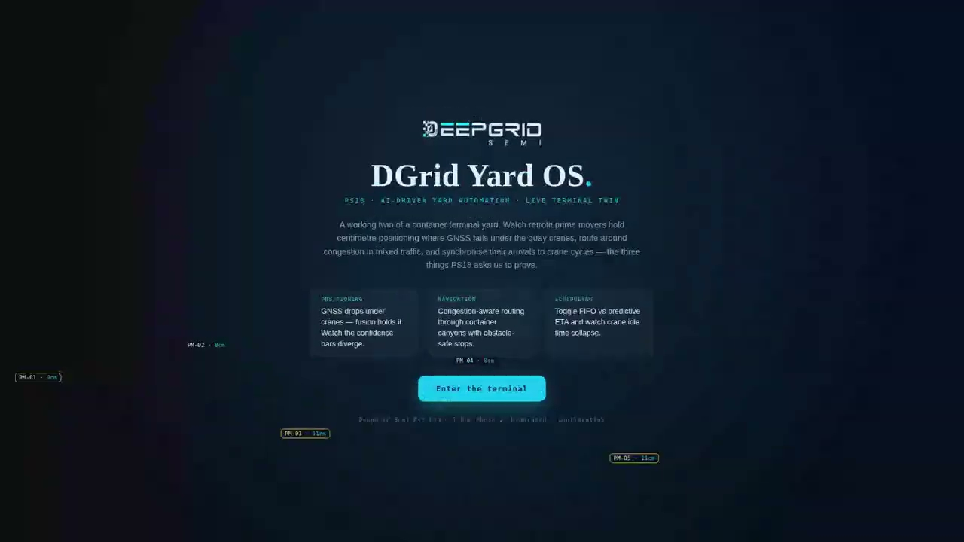
SEAPORT AGV · F
The simulator, running
DGrid Yard OS, recorded running. Quay discharge, then the container canyon, then peak mixed traffic.
The confidence bars
GNSS and fusion diverge entering the canyon. Fusion holds.
The KPI strip
Positioning error open and under crane, ETA error, crane idle saved.
The dispatch toggle
FIFO against predictive ETA, with crane idle moving in response.
Shadow mode
The badge stays on. It advises the terminal before it is given control.
Recorded from the simulator itself; the clip plays in the deck. Simulation, not a fielded deployment.
DEEPGRID SEMI · PRODUCT LINES · MANAGEMENT PROJECTIONS
67
Notes:
[Sources]
Original simulator recording: C:/Users/sheke/Downloads/DeepGrid-Sim-Clips/yard.mp4
Private Drive video: https://drive.google.com/file/d/1TxnH6dmA--6LA5bKlMlwOyh_Pka2qzXA/view?usp=drivesdk
Simulation, not field validation. Video audio muted to prevent non-Holt or duplicate narration; custom Holt voiceover belongs in Google Vids.
[/Sources]
Seaport AGV (port autonomy) — embedded clip of DGrid Yard OS · Live Terminal Twin. The confidence bars: GNSS and fusion diverge entering the canyon. Fusion holds. The KPI strip: Positioning error open and under crane, ETA error, crane idle saved. The dispatch toggle: FIFO against predictive ETA, with crane idle moving in response. Shadow mode: The badge stays on. It advises the terminal before it is given control.

Slide 74
PART FOUR
Sensors & robotics
₹83.5 Cr · 7.4% of FY2032 · 5 SKUs · Capability, channel and a second cycle
DEEPGRID SEMI · PRODUCT LINES · MANAGEMENT PROJECTIONS
68
Notes:
Sensors & robotics: Thermal camera (aftermarket), 4D radar pod (aftermarket), H100 driver-monitor wearable, Defence D-HUMR, D100 drone SoC kit.

Slide 75
THERMAL CAMERA · A
What it is
A bolt-on long-wave infrared camera pod with its own lens and heater, feeding the existing compute box.
₹50,000
Sensors
Outdoor
FY2027
UNIT PRICE
SEGMENT
OPERATING DOMAIN
FIRST REVENUE
WHAT IS IN IT
01
02
03
LWIR thermal sensor and lens
Weatherised housing with lens heater
Harness into the SoC2 compute box
How it is positioned
Thermal camera (aftermarket) sells at ₹50,000 into the sensors & robotics surface. A capability line, not a profit line, at 50% margin — it closes the condition where the core product is weakest.
DEEPGRID SEMI · PRODUCT LINES · MANAGEMENT PROJECTIONS
69
Notes:
Thermal camera (aftermarket) — what it is. Price ₹50,000, segment Sensors, domain Outdoor, first revenue FY2027.

Slide 76
THERMAL CAMERA · B
How it works
Sense, compute on SoC2, decide, act — the same four stages in every product.
SIGNAL CHAIN
1
The LWIR sensor reads emitted heat rather than reflected light
2
SoC2 runs detection on the thermal image, where a person is bright against cold road
3
Classification separates people and animals from roadside clutter
4
Detections join the same object list the cameras feed
What the silicon does here
What this product depends on
Thermal is the channel that keeps working when the others fail — glare, dust, smoke and unlit road. In the perimeter build it is what separates a person from background at night; in the truck kit it is one of eleven fused channels rather than a standalone product.
Thermal sensor supply, which is imported and the highest bill-of-materials risk in the sensor group.
DEEPGRID SEMI · PRODUCT LINES · MANAGEMENT PROJECTIONS
70
Notes:
Thermal camera (aftermarket) — signal chain: The LWIR sensor reads emitted heat rather than reflected light -> SoC2 runs detection on the thermal image, where a person is bright against cold road -> Classification separates people and animals from roadside clutter -> Detections join the same object list the cameras feed. Depends on: Thermal sensor supply, which is imported and the highest bill-of-materials risk in the sensor group.

Slide 77
THERMAL CAMERA · C
Who buys it, and why now
Night and monsoon operation, where camera-only detection degrades sharply.
The buyer
The channel
Fleets upgrading existing vehicles, and as an attach sold alongside AD0 and AD2.
Aftermarket, usually at the same fitment as the base kit.
Demand pool · 0.10% capture at FY2032
Automotive thermal camera $1.68B global (2025). Our FY2032 volume of 3,200 units is 0.10% of that pool.
Source: Verified Market Research: $1.68B 2025, 12% CAGR. Capture rates are management assumptions; pool sizes are third-party published estimates.
DEEPGRID SEMI · PRODUCT LINES · MANAGEMENT PROJECTIONS
71
Notes:
Thermal camera (aftermarket) — buyer: Fleets upgrading existing vehicles, and as an attach sold alongside AD0 and AD2. Channel: Aftermarket, usually at the same fitment as the base kit. Trigger: Night and monsoon operation, where camera-only detection degrades sharply. Pool: Automotive thermal camera $1.68B global (2025) (0.10%). Source: Verified Market Research: $1.68B 2025, 12% CAGR.

Slide 78
THERMAL CAMERA · D
How it fits the overall picture
₹16.0 Cr at FY2032 — 1.4% of group revenue, at 50% gross margin.
3,200
₹16.0 Cr
1.4%
50%
FY2032 UNITS
FY2032 REVENUE
SHARE OF GROUP
GROSS MARGIN
UNITS SHIPPED
REVENUE, ₹ CR
3,200
16
1,800
9
400
900
2
5
40
150
0
1
FY27
FY28
FY29
FY30
FY31
FY32
FY27
FY28
FY29
FY30
FY31
FY32
Its role in the portfolio
What it depends on
A capability line, not a profit line, at 50% margin — it closes the condition where the core product is weakest.
Thermal sensor supply, which is imported and the highest bill-of-materials risk in the sensor group.
DEEPGRID SEMI · PRODUCT LINES · MANAGEMENT PROJECTIONS
72
Notes:
Thermal camera (aftermarket) — units 40 / 150 / 400 / 900 / 1800 / 3200, revenue 0.2 / 0.75 / 2 / 4.5 / 9 / 16 ₹Cr. FY2032 ₹16.0 Cr = 1.42% at 50%. Role: A capability line, not a profit line, at 50% margin — it closes the condition where the core product is weakest.

Slide 79
4D RADAR POD · A
What it is
A sealed radar pod, mounted forward or on the corner, feeding the compute box.
₹25,000
Sensors
Outdoor
FY2027
UNIT PRICE
SEGMENT
OPERATING DOMAIN
FIRST REVENUE
WHAT IS IN IT
01
02
03
4D imaging radar front end
R100 radar DSP processing
Sealed automotive housing and harness
How it is positioned
4D radar pod (aftermarket) sells at ₹25,000 into the sensors & robotics surface. The smallest line at ₹7.5 Cr, but it exists because the radar block is already on the die — the tapeout has paid for the silicon.
DEEPGRID SEMI · PRODUCT LINES · MANAGEMENT PROJECTIONS
73
Notes:
4D radar pod (aftermarket) — what it is. Price ₹25,000, segment Sensors, domain Outdoor, first revenue FY2027.

Slide 80
4D RADAR POD · B
How it works
Sense, compute on SoC2, decide, act — the same four stages in every product.
SIGNAL CHAIN
1
The radar illuminates the scene and reads the returns
2
The R100 block on the die turns returns into range, velocity and elevation
3
Tracks are formed and held across frames, including through rain and dust
4
Tracks fuse with the camera object list to confirm or reject detections
What the silicon does here
What this product depends on
4D radar returns range and velocity in rain, dust and glare, which is precisely where cameras degrade. In the fused suite it is the channel that supplies closing speed — the quantity a collision decision actually turns on.
Radar front-end supply and antenna qualification; the processing is already ours.
DEEPGRID SEMI · PRODUCT LINES · MANAGEMENT PROJECTIONS
74
Notes:
4D radar pod (aftermarket) — signal chain: The radar illuminates the scene and reads the returns -> The R100 block on the die turns returns into range, velocity and elevation -> Tracks are formed and held across frames, including through rain and dust -> Tracks fuse with the camera object list to confirm or reject detections. Depends on: Radar front-end supply and antenna qualification; the processing is already ours.

Slide 81
4D RADAR POD · C
Who buys it, and why now
Weather and dust defeat cameras; radar supplies the closing speed a braking decision needs.
The buyer
The channel
Fleets and integrators adding radar to camera-only fitments.
Aftermarket and integrator supply.
Demand pool · 0.03% capture at FY2032
4D imaging radar $2.75B global (2025). Our FY2032 volume of 3,000 units is 0.03% of that pool.
Source: Business Research Co./Mordor: ~$2.75B 2025, 13% CAGR. Capture rates are management assumptions; pool sizes are third-party published estimates.
DEEPGRID SEMI · PRODUCT LINES · MANAGEMENT PROJECTIONS
75
Notes:
4D radar pod (aftermarket) — buyer: Fleets and integrators adding radar to camera-only fitments. Channel: Aftermarket and integrator supply. Trigger: Weather and dust defeat cameras; radar supplies the closing speed a braking decision needs. Pool: 4D imaging radar $2.75B global (2025) (0.03%). Source: Business Research Co./Mordor: ~$2.75B 2025, 13% CAGR.

Slide 82
4D RADAR POD · D
How it fits the overall picture
₹7.50 Cr at FY2032 — 0.7% of group revenue, at 50% gross margin.
3,000
₹7.50 Cr
0.7%
50%
FY2032 UNITS
FY2032 REVENUE
SHARE OF GROUP
GROSS MARGIN
UNITS SHIPPED
REVENUE, ₹ CR
3,000
8
1,600
4
350
800
1
2
30
120
0
0
FY27
FY28
FY29
FY30
FY31
FY32
FY27
FY28
FY29
FY30
FY31
FY32
Its role in the portfolio
What it depends on
The smallest line at ₹7.5 Cr, but it exists because the radar block is already on the die — the tapeout has paid for the silicon.
Radar front-end supply and antenna qualification; the processing is already ours.
DEEPGRID SEMI · PRODUCT LINES · MANAGEMENT PROJECTIONS
76
Notes:
4D radar pod (aftermarket) — units 30 / 120 / 350 / 800 / 1600 / 3000, revenue 0.07 / 0.3 / 0.88 / 2 / 4 / 7.5 ₹Cr. FY2032 ₹7.50 Cr = 0.66% at 50%. Role: The smallest line at ₹7.5 Cr, but it exists because the radar block is already on the die — the tapeout has paid for the silicon.

Slide 83
H100 DRIVER MONITOR · A
What it is
A wrist-worn band with an on-body sensor set and a radio link to the vehicle.
₹5,000
Sensors
Outdoor
FY2027
UNIT PRICE
SEGMENT
OPERATING DOMAIN
FIRST REVENUE
WHAT IS IN IT
01
02
03
04
PPG and motion sensing band
On-device fatigue model
Radio link into the vehicle alert chain
Charging and fleet enrolment tooling
How it is positioned
H100 driver-monitor wearable sells at ₹5,000 into the sensors & robotics surface. The lowest-priced item we sell at ₹5,000 and the cheapest way into a fleet relationship; ₹10 Cr of revenue makes it a channel line, not a profit line.
DEEPGRID SEMI · PRODUCT LINES · MANAGEMENT PROJECTIONS
77
Notes:
H100 driver-monitor wearable — what it is. Price ₹5,000, segment Sensors, domain Outdoor, first revenue FY2027.

Slide 84
H100 DRIVER MONITOR · B
How it works
Sense, compute on SoC2, decide, act — the same four stages in every product.
SIGNAL CHAIN
1
The band reads pulse and movement continuously on the driver
2
An on-device model scores alertness without sending raw data anywhere
3
A drowsiness state crosses a threshold
4
The vehicle alert chain warns the driver and the fleet is notified
What the silicon does here
What this product depends on
The SoC2 stage is common to every SKU: it is the same perception compute under different firmware. For H100 driver monitor it runs stage two of the chain above.
Driver acceptance and enrolment discipline, which is an operational problem rather than a technical one.
DEEPGRID SEMI · PRODUCT LINES · MANAGEMENT PROJECTIONS
78
Notes:
H100 driver-monitor wearable — signal chain: The band reads pulse and movement continuously on the driver -> An on-device model scores alertness without sending raw data anywhere -> A drowsiness state crosses a threshold -> The vehicle alert chain warns the driver and the fleet is notified. Depends on: Driver acceptance and enrolment discipline, which is an operational problem rather than a technical one.

Slide 85
H100 DRIVER MONITOR · C
Who buys it, and why now
Driver-drowsiness obligations, and fleets wanting a lower-intrusion option than in-cab video.
The buyer
The channel
Fleets meeting drowsiness obligations without fitting a cabin camera.
Fleet direct, often as the first purchase a fleet makes from us.
Demand pool · — capture at FY2032
DDAWS mandate (AIS-184) + global DMS demand. Our FY2032 volume of 20,000 units is — of that pool.
Source: MoRTH AIS-184; EU Reg 2021/267 (commercial DMS). Capture rates are management assumptions; pool sizes are third-party published estimates.
DEEPGRID SEMI · PRODUCT LINES · MANAGEMENT PROJECTIONS
79
Notes:
H100 driver-monitor wearable — buyer: Fleets meeting drowsiness obligations without fitting a cabin camera. Channel: Fleet direct, often as the first purchase a fleet makes from us. Trigger: Driver-drowsiness obligations, and fleets wanting a lower-intrusion option than in-cab video. Pool: DDAWS mandate (AIS-184) + global DMS demand (—). Source: MoRTH AIS-184; EU Reg 2021/267 (commercial DMS).

Slide 86
H100 DRIVER MONITOR · D
How it fits the overall picture
₹10.0 Cr at FY2032 — 0.9% of group revenue, at 50% gross margin.
20,000
₹10.0 Cr
0.9%
50%
FY2032 UNITS
FY2032 REVENUE
SHARE OF GROUP
GROSS MARGIN
UNITS SHIPPED
REVENUE, ₹ CR
20,000
10
11,000
6
2,200
5,000
3
200
800
0
0
1
FY27
FY28
FY29
FY30
FY31
FY32
FY27
FY28
FY29
FY30
FY31
FY32
Its role in the portfolio
What it depends on
The lowest-priced item we sell at ₹5,000 and the cheapest way into a fleet relationship; ₹10 Cr of revenue makes it a channel line, not a profit line.
Driver acceptance and enrolment discipline, which is an operational problem rather than a technical one.
DEEPGRID SEMI · PRODUCT LINES · MANAGEMENT PROJECTIONS
80
Notes:
H100 driver-monitor wearable — units 200 / 800 / 2200 / 5000 / 11000 / 20000, revenue 0.1 / 0.4 / 1.1 / 2.5 / 5.5 / 10 ₹Cr. FY2032 ₹10.0 Cr = 0.89% at 50%. Role: The lowest-priced item we sell at ₹5,000 and the cheapest way into a fleet relationship; ₹10 Cr of revenue makes it a channel line, not a profit line.

Slide 87
DEFENCE D-HUMR · A
What it is
An unmanned ground vehicle for defence logistics and reconnaissance.
₹20.00 L
Robotics
Outdoor
FY2027
UNIT PRICE
SEGMENT
OPERATING DOMAIN
FIRST REVENUE
WHAT IS IN IT
01
02
03
04
UGV platform with surround sensing
SoC2 compute and autonomy stack
Teleoperation link
Mission payload interface
How it is positioned
Defence D-HUMR sells at ₹20.00 L into the sensors & robotics surface. Revenue has already been received on this line, on FPGA hardware, which makes it the portfolio's earliest external validation.
DEEPGRID SEMI · PRODUCT LINES · MANAGEMENT PROJECTIONS
81
Notes:
Defence D-HUMR — what it is. Price ₹20.00 L, segment Robotics, domain Outdoor, first revenue FY2027.

Slide 88
DEFENCE D-HUMR · B
How it works
Sense, compute on SoC2, decide, act — the same four stages in every product.
SIGNAL CHAIN
1
Surround sensing reads terrain, obstacles and people
2
SoC2 builds a local map and plans a traversable route
3
Autonomy drives, with a teleoperator able to take control
4
Mission payload does its job at the destination
What the silicon does here
What this product depends on
The defence build runs the fusion stack outward instead of forward: radar, thermal and camera tracks along a perimeter are classified individually, then correlated, so a vehicle loitering on an access road and a person at the fence stop being two unrelated blips.
Procurement cycle timing, which is slow and lumpy rather than technical.
DEEPGRID SEMI · PRODUCT LINES · MANAGEMENT PROJECTIONS
82
Notes:
Defence D-HUMR — signal chain: Surround sensing reads terrain, obstacles and people -> SoC2 builds a local map and plans a traversable route -> Autonomy drives, with a teleoperator able to take control -> Mission payload does its job at the destination. Depends on: Procurement cycle timing, which is slow and lumpy rather than technical.

Slide 89
DEFENCE D-HUMR · C
Who buys it, and why now
Logistics and reconnaissance tasks where sending a vehicle is preferable to sending people.
The buyer
The channel
Indian Army and MoD procurement programmes.
Government procurement, including GeM listing.
Demand pool · — capture at FY2032
Indian Army UGV/robotics procurement. Our FY2032 volume of 150 units is — of that pool.
Source: MoD/Army programs (existing Rs1 Cr revenue). Capture rates are management assumptions; pool sizes are third-party published estimates.
DEEPGRID SEMI · PRODUCT LINES · MANAGEMENT PROJECTIONS
83
Notes:
Defence D-HUMR — buyer: Indian Army and MoD procurement programmes. Channel: Government procurement, including GeM listing. Trigger: Logistics and reconnaissance tasks where sending a vehicle is preferable to sending people. Pool: Indian Army UGV/robotics procurement (—). Source: MoD/Army programs (existing Rs1 Cr revenue).

Slide 90
DEFENCE D-HUMR · D
How it fits the overall picture
₹30.0 Cr at FY2032 — 2.7% of group revenue, at 68% gross margin.
150
₹30.0 Cr
2.7%
68%
FY2032 UNITS
FY2032 REVENUE
SHARE OF GROUP
GROSS MARGIN
UNITS SHIPPED
REVENUE, ₹ CR
150
30
88
18
23
45
5
9
6
15
1
3
FY27
FY28
FY29
FY30
FY31
FY32
FY27
FY28
FY29
FY30
FY31
FY32
Its role in the portfolio
What it depends on
Revenue has already been received on this line, on FPGA hardware, which makes it the portfolio's earliest external validation.
Procurement cycle timing, which is slow and lumpy rather than technical.
DEEPGRID SEMI · PRODUCT LINES · MANAGEMENT PROJECTIONS
84
Notes:
Defence D-HUMR — units 6 / 15 / 23 / 45 / 88 / 150, revenue 1.2 / 3 / 4.6 / 9 / 17.6 / 30 ₹Cr. FY2032 ₹30.0 Cr = 2.66% at 68%. Role: Revenue has already been received on this line, on FPGA hardware, which makes it the portfolio's earliest external validation.

Slide 91
DEFENCE D-HUMR · E
Proven in a working simulator
PS16 · a live console for intelligent perimeter threat detection
LIVE DEMONSTRATOR
DGrid Sentinel · Perimeter Threat Fusion
Correlate
Escalate
An external vehicle track and a fence-line human track fuse into one threat, which neither sensor would raise alone.
Loiter → approach → breach risk on a timed ladder, so the operator sees intent forming rather than an alarm at the breach.
Hand off
Restraint is the feature
Ground sensors, a patrol drone and a sea buoy share the same target track.
Benign tracks are held and monitored but never escalated — false-alarm rate is what gets a perimeter system switched off.
The demonstrator runs the production perception stack against a simulated environment. It is evidence of the decision layer, not of a fielded deployment.
DEEPGRID SEMI · PRODUCT LINES · MANAGEMENT PROJECTIONS
85
Notes:
Defence D-HUMR — demonstrator DGrid Sentinel · Perimeter Threat Fusion. Correlate: An external vehicle track and a fence-line human track fuse into one threat, which neither sensor would raise alone. Escalate: Loiter → approach → breach risk on a timed ladder, so the operator sees intent forming rather than an alarm at the breach. Hand off: Ground sensors, a patrol drone and a sea buoy share the same target track. Restraint is the feature: Benign tracks are held and monitored but never escalated — false-alarm rate is what gets a perimeter system switched off.

Slide 92

DEFENCE D-HUMR · F
The simulator, running
DGrid Sentinel, recorded running. Coordinated intrusion, then perimeter patrol, then a maritime approach.
Two tracks becoming one
A vehicle on the access road and a human at the fence fuse into one threat.
The escalation ladder
Loiter, approach, breach risk — the operator sees intent forming.
The fusion rationale
The console says why it escalated, in words, not as a bare alarm.
What it ignores
Benign tracks are held and never escalated. That restraint is the product.
Recorded from the simulator itself; the clip plays in the deck. Simulation, not a fielded deployment.
DEEPGRID SEMI · PRODUCT LINES · MANAGEMENT PROJECTIONS
86
Notes:
[Sources]
Original simulator recording: C:/Users/sheke/Downloads/DeepGrid-Sim-Clips/sentinel.mp4
Private Drive video: https://drive.google.com/file/d/1zCGfs3HElHq7j_Vz9-EilIRoi7dSiMVX/view?usp=drivesdk
Simulation, not field validation. Video audio muted to prevent non-Holt or duplicate narration; custom Holt voiceover belongs in Google Vids.
[/Sources]
Defence D-HUMR — embedded clip of DGrid Sentinel · Perimeter Threat Fusion. Two tracks becoming one: A vehicle on the access road and a human at the fence fuse into one threat. The escalation ladder: Loiter, approach, breach risk — the operator sees intent forming. The fusion rationale: The console says why it escalated, in words, not as a bare alarm. What it ignores: Benign tracks are held and never escalated. That restraint is the product.

Slide 93
D100 DRONE SOC KIT · A
What it is
A flight-capable compute and perception kit for an airframe builder.
₹5.00 L
Robotics
Outdoor
FY2028
UNIT PRICE
SEGMENT
OPERATING DOMAIN
FIRST REVENUE
WHAT IS IN IT
01
02
03
04
Flight-weight SoC2 compute module
Camera and IMU sensing set
Flight-controller interface
SDK for airborne perception
How it is positioned
D100 drone SoC kit sells at ₹5.00 L into the sensors & robotics surface. Opens a procurement cycle unlike automotive for little incremental engineering, because the perception problem is the same one with the ground removed.
DEEPGRID SEMI · PRODUCT LINES · MANAGEMENT PROJECTIONS
87
Notes:
D100 drone SoC kit — what it is. Price ₹5.00 L, segment Robotics, domain Outdoor, first revenue FY2028.

Slide 94
D100 DRONE SOC KIT · B
How it works
Sense, compute on SoC2, decide, act — the same four stages in every product.
SIGNAL CHAIN
1
Cameras and IMU read the scene and the airframe's own motion
2
SoC2 runs perception and visual odometry in flight
3
Planner produces waypoints or avoidance manoeuvres
4
The flight controller executes them
What the silicon does here
What this product depends on
The SoC2 stage is common to every SKU: it is the same perception compute under different firmware. For D100 drone SoC kit it runs stage two of the chain above.
Weight and power budget, which is tighter in the air than on a vehicle.
DEEPGRID SEMI · PRODUCT LINES · MANAGEMENT PROJECTIONS
88
Notes:
D100 drone SoC kit — signal chain: Cameras and IMU read the scene and the airframe's own motion -> SoC2 runs perception and visual odometry in flight -> Planner produces waypoints or avoidance manoeuvres -> The flight controller executes them. Depends on: Weight and power budget, which is tighter in the air than on a vehicle.

Slide 95
D100 DRONE SOC KIT · C
Who buys it, and why now
Onboard autonomy requirements where a radio link cannot be relied on.
The buyer
The channel
Defence and commercial drone manufacturers.
Direct to airframe builders.
Demand pool · — capture at FY2032
India defence + commercial drone SoC. Our FY2032 volume of 400 units is — of that pool.
Source: Edge-AI drones segment (Mordor 18% CAGR). Capture rates are management assumptions; pool sizes are third-party published estimates.
DEEPGRID SEMI · PRODUCT LINES · MANAGEMENT PROJECTIONS
89
Notes:
D100 drone SoC kit — buyer: Defence and commercial drone manufacturers. Channel: Direct to airframe builders. Trigger: Onboard autonomy requirements where a radio link cannot be relied on. Pool: India defence + commercial drone SoC (—). Source: Edge-AI drones segment (Mordor 18% CAGR).

Slide 96
D100 DRONE SOC KIT · D
How it fits the overall picture
₹20.0 Cr at FY2032 — 1.8% of group revenue, at 68% gross margin.
400
₹20.0 Cr
1.8%
68%
FY2032 UNITS
FY2032 REVENUE
SHARE OF GROUP
GROSS MARGIN
UNITS SHIPPED
REVENUE, ₹ CR
400
20
225
11
50
125
3
6
0
5
0
0
FY27
FY28
FY29
FY30
FY31
FY32
FY27
FY28
FY29
FY30
FY31
FY32
Its role in the portfolio
What it depends on
Opens a procurement cycle unlike automotive for little incremental engineering, because the perception problem is the same one with the ground removed.
Weight and power budget, which is tighter in the air than on a vehicle.
DEEPGRID SEMI · PRODUCT LINES · MANAGEMENT PROJECTIONS
90
Notes:
D100 drone SoC kit — units 0 / 5 / 50 / 125 / 225 / 400, revenue 0 / 0.25 / 2.5 / 6.25 / 11.25 / 20 ₹Cr. FY2032 ₹20.0 Cr = 1.77% at 68%. Role: Opens a procurement cycle unlike automotive for little incremental engineering, because the perception problem is the same one with the ground removed.

Slide 97
PART FIVE
Portfolio economics
Concentration, sequencing, operating domains, the margin ladder and demand headroom
DEEPGRID SEMI · PRODUCT LINES · MANAGEMENT PROJECTIONS
91
Notes:
Economics section.

Slide 98
CONCENTRATION
Two SKUs carry 64%, thirteen carry the rest
FY2032 revenue by SKU. Colour shows platform surface.
Smart Truck (AD2 kit)
₹450 Cr
AD0 Smart Mirror
₹270 Cr
Autonomous TaaS
₹66.0 Cr
Chipset OEM B2B
₹54.0 Cr
T100 AI licence
₹50.0 Cr
AD1 Indoor L4 kit
₹42.0 Cr
A100 compute box 4ch PCIe
₹36.0 Cr
Defence D-HUMR
₹30.0 Cr
A100 compute box 2ch
₹28.8 Cr
A100 compute box 1ch M.2
₹25.5 Cr
Seaport AGV
₹22.6 Cr
D100 drone SoC kit
₹20.0 Cr
Thermal camera
₹16.0 Cr
H100 driver monitor
₹10.0 Cr
4D radar pod
₹7.50 Cr
AD2 and AD0 are the same product family sold to overlapping buyers, so a certification or installation delay hits ₹720 Cr at once — larger than the other thirteen SKUs combined.
DEEPGRID SEMI · PRODUCT LINES · MANAGEMENT PROJECTIONS
92
Notes:
Revenue Build FY2032 column.

Slide 99
SEQUENCING
Six SKUs earn in FY2027, nine more in FY2028
First revenue year per SKU. FY2027 is FPGA-based product only.
FIRST REVENUE
SKUS
WHAT SWITCHES ON
FY2027
6
AD0 Smart Mirror · Smart Truck (AD2 kit) · Thermal camera · 4D radar pod · H100 driver monitor · Defence D-HUMR
FY2028
8
AD1 Indoor L4 kit · Autonomous TaaS · Seaport AGV · Chipset OEM B2B · A100 compute box 1ch M.2 · A100 compute box 2ch · A100 compute box 4ch PCIe · D100 drone SoC kit
FY2029
1
T100 AI licence
Why the shape matters
FY2027 revenue is FPGA-based product and robot sales only — ₹1.7 Cr across six SKUs. Nine more begin earning in FY2028 as ASIC-era product reaches market, and the licence line starts in FY2029. The ramp is gated by silicon, which is what the round funds.
DEEPGRID SEMI · PRODUCT LINES · MANAGEMENT PROJECTIONS
93
Notes:
Launch year = first non-zero revenue year per SKU.

Slide 100
WHERE AUTONOMY RUNS
Outdoor carries it; indoor ships L4 sooner
The same chip across three operating domains, with different regulatory exposure.
86.3%
8.0%
5.7%
15
OUTDOOR AUTONOMY
GENERAL COMPUTE
INDOOR AUTONOMY
SKUS IN TOTAL
DOMAIN
SKUS
FY2032 REVENUE
SHARE
WHAT IT COVERS
Outdoor autonomy
10
₹974 Cr
86.3%
Road, fleet, sensing, defence — anything on a public road or open site
General compute
3
₹90.3 Cr
8.0%
A100 modules sold as silicon, with no vehicle attached
Indoor autonomy
2
₹64.7 Cr
5.7%
Geofenced level-4: warehouse kits and port vehicles
The regulatory asymmetry
Outdoor revenue depends on homologation and public-road rules. Indoor is geofenced, so level-4 ships years earlier on the same chip. Compute carries no vehicle exposure at all.
DEEPGRID SEMI · PRODUCT LINES · MANAGEMENT PROJECTIONS
94
Notes:
Revenue Build section C.

Slide 101
MARGIN
Volume and margin sit in different places
Systems carry the revenue; semiconductors carry the profit per rupee.
SEGMENT
SKUS
FY2032 REVENUE
SHARE OF REVENUE
FY2032 GROSS MARGIN
Systems
8
₹941 Cr
83.4%
89%
Semiconductors
2
₹104 Cr
9.2%
94%
Robotics
2
₹50.0 Cr
4.4%
68%
Sensors
3
₹33.5 Cr
3.0%
50%
How to read the two together
Group economics track systems, because systems are 83.4% of revenue. But the marginal rupee is worth most in semiconductors at 94%, and those SKUs need no installation capacity. Growth in the silicon SKUs improves group margin without adding operational load.
DEEPGRID SEMI · PRODUCT LINES · MANAGEMENT PROJECTIONS
95
Notes:
Segment totals computed from the fifteen SKUs.

Slide 102
HEADROOM
No SKU assumes we win its market
FY2032 share of each SKU's own sized demand pool. Axis runs to 2%.
AD0 Smart Mirror
0.93%
Smart Truck (AD2 kit)
1.80%
Autonomous TaaS
0.01%
Seaport AGV
0.02%
Thermal camera
0.10%
4D radar pod
0.03%
Chipset OEM B2B
0.25%
A100 compute box (3 SKUs)
0.20%
Why the shares look small
The one to read differently
Most pools are global while our serviceable market is the India slice, so the real share is higher. The three A100 SKUs share one pool row; T100 has none.
Seaport AGV shows 0.02% against a pool that is total port automation, cranes and software included. We sell only the vehicle layer.
Capture rates are management assumptions; pool sizes are third-party published estimates.
DEEPGRID SEMI · PRODUCT LINES · MANAGEMENT PROJECTIONS
96
Notes:
Demand & TAM section B capture column; A100 collapsed to its single pool row.

Slide 103
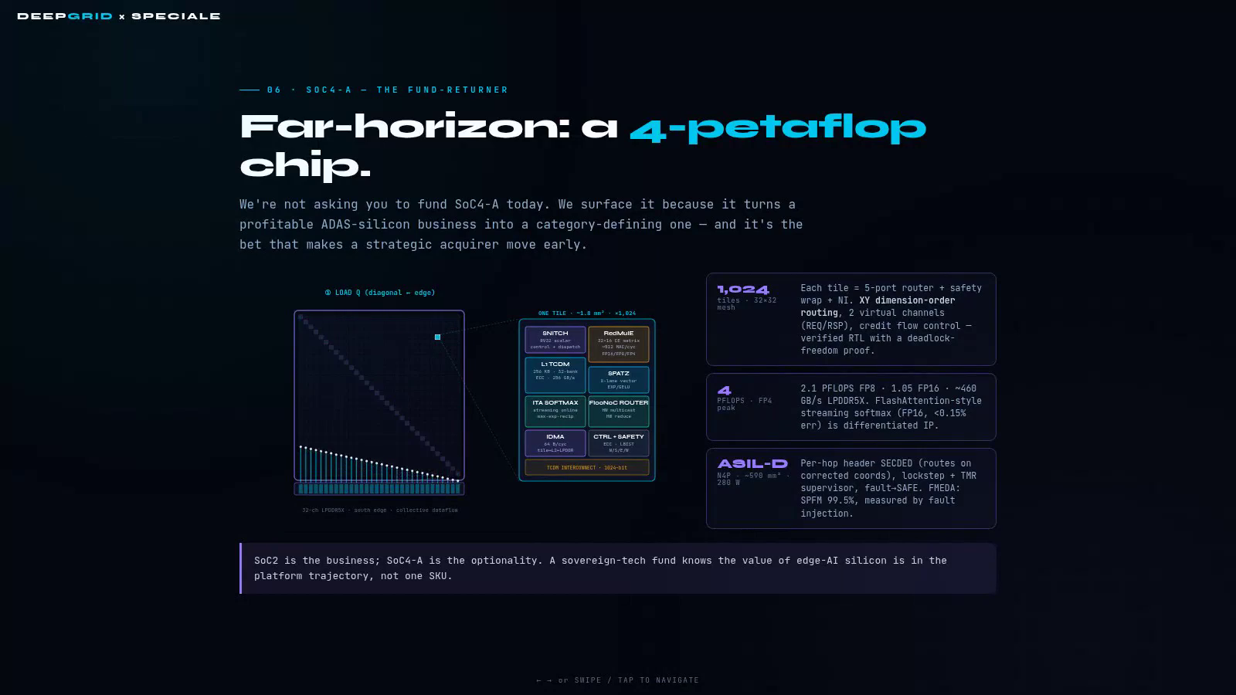
See the far-horizon part this raise does not fund
SoC4-A optionality, outside this plan—built from published open PULP silicon IP.
Click the video to play · Narrated · No music

Slide 104
THE ASK
Fund the silicon; the portfolio follows
Fifteen SKUs, one tapeout. Release capital against silicon, certification and paying customers — not against the forecast.
Legislated demand
One tapeout
Margin where it counts
A floor, not a stretch
A million trucks a year in scope
All fifteen SKUs downstream of a single 28 nm chip
94% on silicon, needing no installation capacity
Under 2% of every sized pool, prices flat six years
The portfolio is not fifteen bets. It is one bet, fifteen times over.
All figures are management projections prepared for fundraising purposes and are not audited or reported results.
DEEPGRID SEMI · PRODUCT LINES · AUGUST 2026
97
Notes:
Close.

